Slide 1




Supercomputing in Plain English
Overview:
What the Heck is Supercomputing?
Henry Neeman, Director
Director, OU Supercomputing Center for Education & Research (OSCER)
Assistant Vice President, Information Technology – Research Strategy Advisor
Associate Professor, College of Engineering
Adjunct Associate Professor, School of Computer Science
University of Oklahoma
Tuesday January 20 2015

Slide 2
This is an experiment!
It’s the nature of these kinds of videoconferences that FAILURES ARE GUARANTEED TO HAPPEN! NO PROMISES!
So, please bear with us. Hopefully everything will work out well enough.
If you lose your connection, you can retry the same kind of connection, or try connecting another way.
Remember, if all else fails, you always have the toll free phone bridge to fall back on.

Slide 3
PLEASE MUTE YOURSELF
No matter how you connect, PLEASE MUTE YOURSELF, so that we cannot hear you.
At OU, we will turn off the sound on all conferencing technologies.
That way, we won’t have problems with echo cancellation.
Of course, that means we cannot hear questions.
So for questions, you’ll need to send e-mail.
PLEASE MUTE YOURSELF.
PLEASE MUTE YOURSELF.

Slide 4
Download the Slides Beforehand
Before the start of the session, please download the slides from the Supercomputing in Plain English website:
http://www.oscer.ou.edu/education/
That way, if anything goes wrong, you can still follow along with just audio.
PLEASE MUTE YOURSELF.

Slide 5
H.323 (Polycom etc) #1
If you want to use H.323 videoconferencing – for example, Polycom – then:
If you AREN’T registered with the OneNet gatekeeper (which is probably the case), then:
  Dial 164.58.250.47
  Bring up the virtual keypad.
  On some H.323 devices, you can bring up the virtual keypad by typing:
  #
  (You may want to try without first, then with; some devices won't work with the #, but give cryptic error messages about it.)
  When asked for the conference ID, or if there's no response, enter:
  0409
  On most but not all H.323 devices, you indicate the end of the ID with:
  #

Slide 6
H.323 (Polycom etc) #2
If you want to use H.323 videoconferencing – for example, Polycom – then:
If you ARE already registered with the OneNet gatekeeper (most institutions aren’t), dial:
2500409
Many thanks to James Deaton, Skyler Donahue, Jeremy Wright and Steven Haldeman of OneNet for providing this.
PLEASE MUTE YOURSELF.

Slide 7
Wowza #1
You can watch from a Windows, MacOS or Linux laptop using Wowza from the following URL:
http://jwplayer.onenet.net/stream6/sipe.html
Wowza behaves a lot like YouTube, except live.
Many thanks to James Deaton, Skyler Donahue, Jeremy Wright and Steven Haldeman of OneNet for providing this.
PLEASE MUTE YOURSELF.

Slide 8
Wowza #2
Wowza has been tested on multiple browsers on each of:
Windows (7 and 8): IE, Firefox, Chrome, Opera, Safari
MacOS X: Safari, Firefox
Linux: Firefox, Opera
We’ve also successfully tested it on devices with:
Android
iOS
However, we make no representations on the likelihood of it working on your device, because we don’t know which versions of Android or iOS it mi
PLEASE MUTE YOURSELF.
ght or might not work with.

Slide 9
Toll Free Phone Bridge
IF ALL ELSE FAILS, you can use our toll free phone bridge:
800-832-0736
* 623 2874 #
Please mute yourself and use the phone to listen.
Don’t worry, we’ll call out slide numbers as we go.
Please use the phone bridge ONLY if you cannot connect any other way: the phone bridge can handle only 100 simultaneous connections, and we have over 500 participants.
Many thanks to OU CIO Loretta Early for providing the toll free phone bridge.
PLEASE MUTE YOURSELF.

Slide 10
Please Mute Yourself
No matter how you connect, PLEASE MUTE YOURSELF, so that we cannot hear you.
(For Wowza, you don’t need to do that, because the information only goes from us to you, not from you to us.)
At OU, we will turn off the sound on all conferencing technologies.
That way, we won’t have problems with echo cancellation.
Of course, that means we cannot hear questions.
So for questions, you’ll need to send e-mail.
PLEASE MUTE YOURSELF.
PLEASE MUTE YOURSELF.

Slide 11
Questions via E-mail Only
Ask questions by sending e-mail to:
sipe2015@gmail.com
All questions will be read out loud and then answered out loud.
PLEASE MUTE YOURSELF.

Slide 12
Onsite: Talent Release Form
If you’re attending onsite, you MUST do one of the following:
complete and sign the Talent Release Form,
OR
sit behind the cameras (where you can’t be seen) and don’t talk at all.
If you aren’t onsite, then PLEASE MUTE YOURSELF.

Slide 13
TENTATIVE Schedule
Tue Jan 20: Overview: What the Heck is Supercomputing?
Tue Jan 27: The Tyranny of the Storage Hierarchy
Tue Feb 3: Instruction Level Parallelism
Tue Feb 10: Stupid Compiler Tricks
Tue Feb 17: Shared Memory Multithreading
Tue Feb 24: Distributed Multiprocessing
Tue March 3: Applications and Types of Parallelism
Tue March 10: Multicore Madness
Tue March 17: NO SESSION (OU's Spring Break)
Tue March 24: NO SESSION (Henry has a huge grant proposal due)
Tue March 31: High Throughput Computing
Tue Apr 7: GPGPU: Number Crunching in Your Graphics Card
Tue Apr 14: Grab Bag: Scientific Libraries, I/O Libraries, Visualization

Slide 14
Thanks for helping!
OU IT
  OSCER operations staff (Brandon George, Dave Akin, Brett Zimmerman, Josh Alexander, Patrick Calhoun)
  Horst Severini, OSCER Associate Director for Remote & Heterogeneous Computing
  Debi Gentis, OSCER Coordinator
  Jim Summers
  The OU IT network team
James Deaton, Skyler Donahue, Jeremy Wright and Steven Haldeman, OneNet
Kay Avila, U Iowa
Stephen Harrell, Purdue U

Slide 15
This is an experiment!
It’s the nature of these kinds of videoconferences that FAILURES ARE GUARANTEED TO HAPPEN! NO PROMISES!
So, please bear with us. Hopefully everything will work out well enough.
If you lose your connection, you can retry the same kind of connection, or try connecting another way.
Remember, if all else fails, you always have the toll free phone bridge to fall back on.
PLEASE MUTE YOURSELF.

Slide 16
Coming in 2015!
Red Hat Tech Day, Thu Jan 22 2015 @ OU
http://goo.gl/forms/jORZCz9xh7
Linux Clusters Institute workshop May 18-22 2015 @ OU
http://www.linuxclustersinstitute.org/workshops/
Great Plains Network Annual Meeting, May 27-29, Kansas City
Advanced Cyberinfrastructure Research & Education Facilitators (ACI-REF) Virtual Residency May 31 - June 6 2015
XSEDE2015, July 26-30, St. Louis MO
https://conferences.xsede.org/xsede15
IEEE Cluster 2015, Sep 23-27, Chicago IL
http://www.mcs.anl.gov/ieeecluster2015/
OKLAHOMA SUPERCOMPUTING SYMPOSIUM 2015, Sep 22-23 2015 @ OU
SC13, Nov 15-20 2015, Austin TX
http://sc15.supercomputing.org/
PLEASE MUTE YOURSELF.

Slide 17
Supercomputing in Plain English

Slide 18
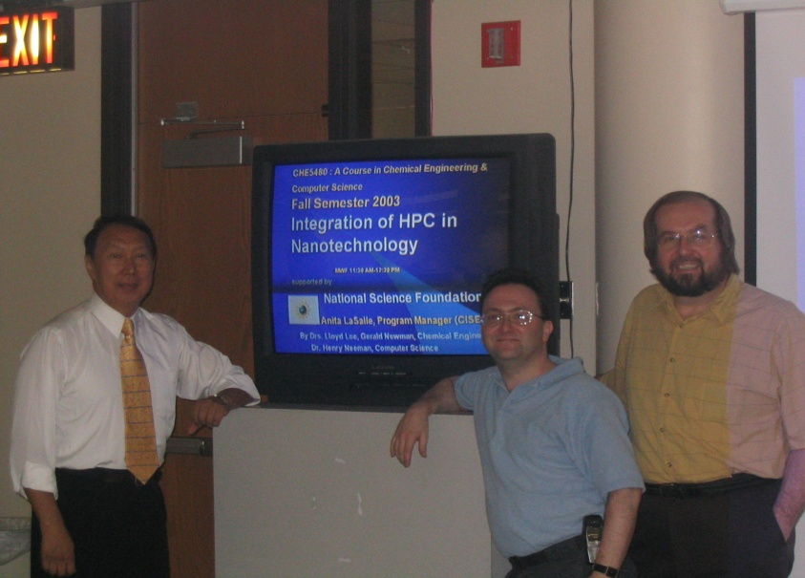
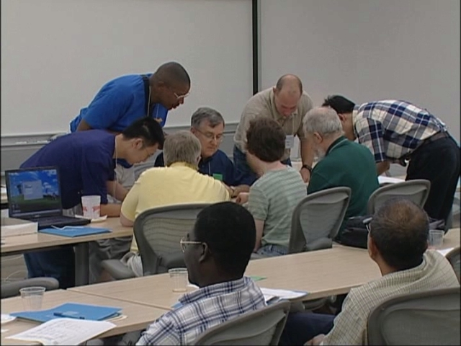
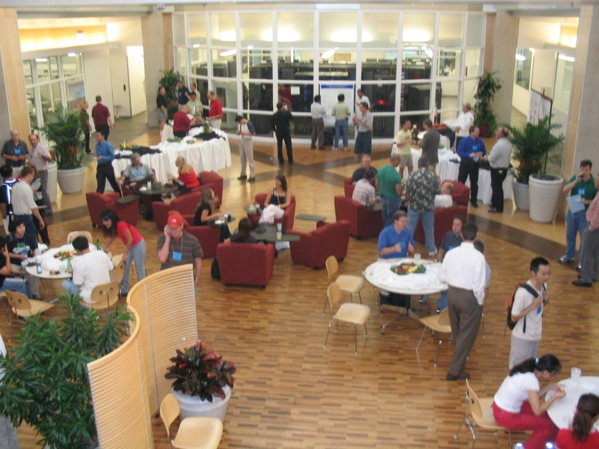
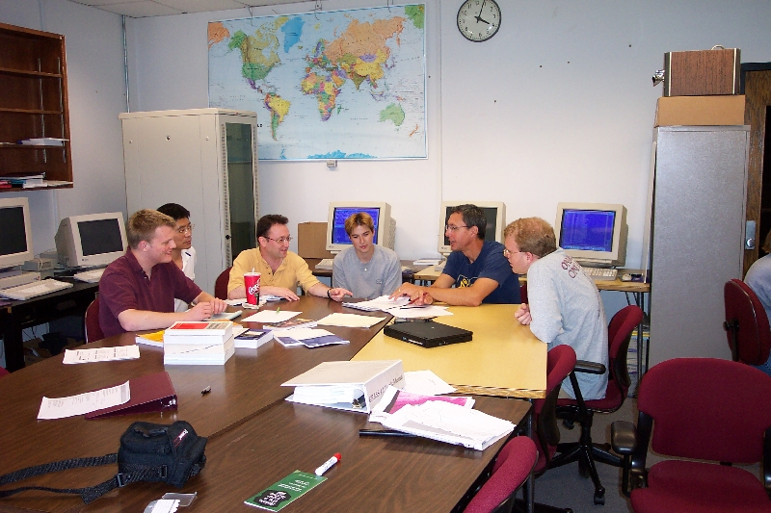
People

Slide 19
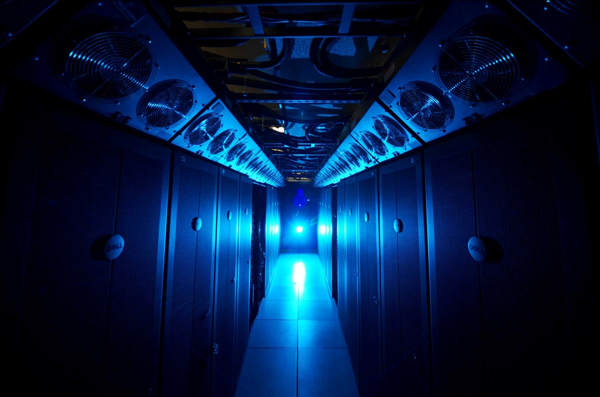
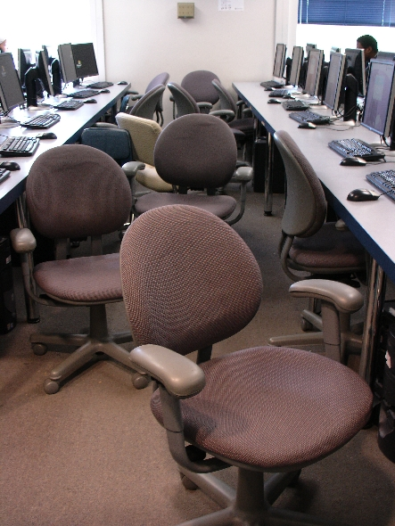
Things

Slide 20
Thanks for your attention!
Questions? www.oscer.ou.edu

Slide 21
What is Supercomputing?
Supercomputing is the biggest, fastest computing right this minute.
Likewise, a supercomputer is one of the biggest, fastest computers right this minute.
So, the definition of supercomputing is constantly changing.
Rule of Thumb: A supercomputer is typically at least 100 times as powerful as a PC.
Jargon: Supercomputing is also known as High Performance Computing (HPC) or High End Computing (HEC) or Cyberinfrastructure (CI).

Slide 22
Fastest Supercomputer vs. Moore
Speed in GFLOPs
GFLOPs:
billions of calculations per second
www.top500.org
Year

Slide 23
What is Supercomputing About?
Size
Speed
Laptop

Slide 24
What is Supercomputing About?
Size: Many problems that are interesting to scientists and engineers can’t fit on a PC – usually because they need more than a few GB of RAM, or more than a few 100 GB of disk.
Speed: Many problems that are interesting to scientists and engineers would take a very very long time to run on a PC: months or even years. But a problem that would take a month on a PC might take only an hour on a supercomputer.

Slide 25
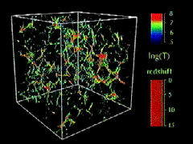
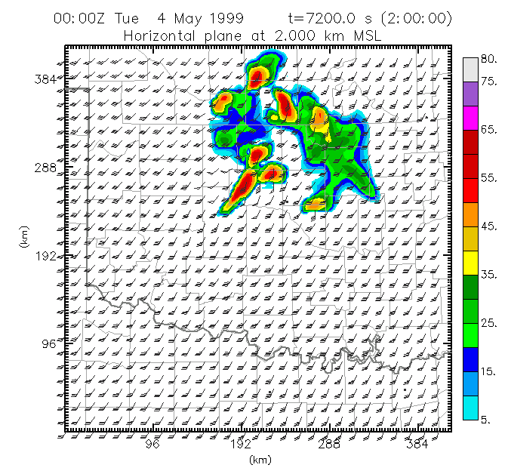
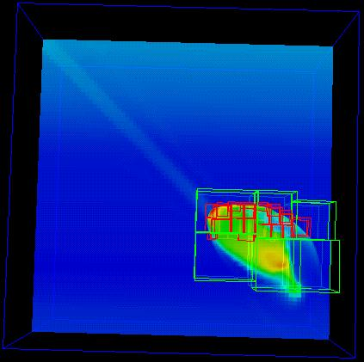
What Is HPC Used For?
Simulation of physical phenomena, such as
  Weather forecasting
  Galaxy formation
  Oil reservoir management
Data mining: finding needles of information in a haystack of data,
such as
  Gene sequencing
  Signal processing
  Detecting storms that might produce tornados
Visualization: turning a vast sea of data into pictures that a scientist can understand
^{[1]}
Moore, OK
Tornadic
Storm
May 3 1999^{[2]}
^{[3]}

Slide 26
Supercomputing Issues
The tyranny of the storage hierarchy
Parallelism: doing multiple things at the same time

Slide 27

What is a Cluster Supercomputer?
“… [W]hat a ship is … It's not just a keel and hull and a deck and sails. That's what a ship needs. But what a ship is ... is freedom.”
– Captain Jack Sparrow
“Pirates of the Caribbean”
http://lh3.ggpht.com/_6hgSmco4R9M/SfpFA3057zI/AAAAAAAACSg/G-AGCgLrQOk/s1600-h/pirates%5B5%5D.jpg

Slide 28
What a Cluster is ….
A cluster needs of a collection of small computers, called nodes, hooked together by an interconnection network (or interconnect for short).
It also needs software that allows the nodes to communicate over the interconnect.
But what a cluster is … is all of these components working together as if they’re one big computer ... a super computer.

Slide 29
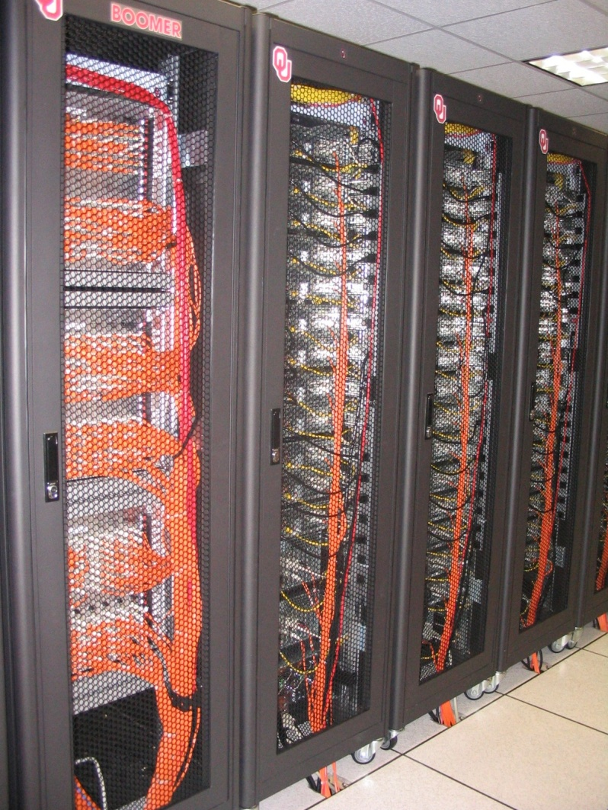
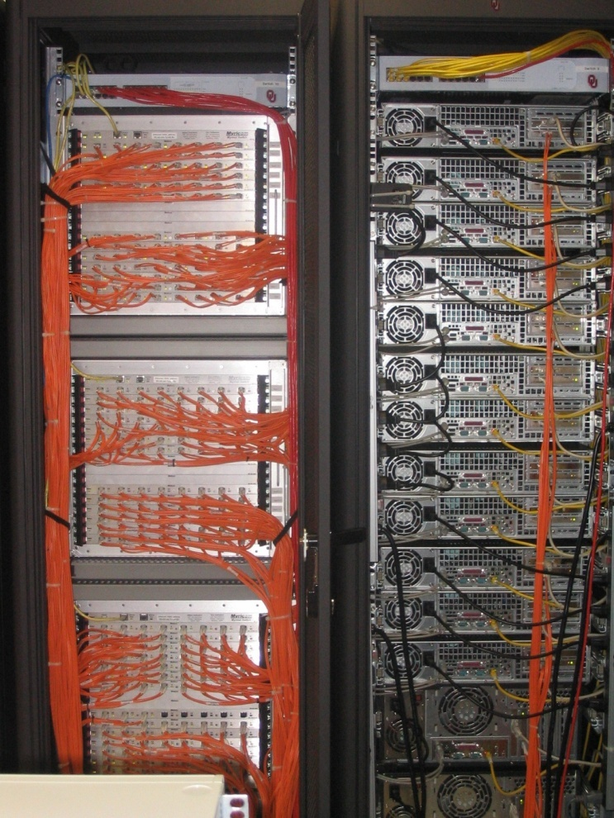
An Actual Cluster
Interconnect
Also named Boomer, in service 2002-5.
Nodes

Slide 30
A Quick Primer on Hardware

Slide 31

Henry’s Laptop
Dell Latitude E5540^{[4]}
Intel Core i3-4010U dual core, 1.7 GHz, 3 MB L3 Cache
12 GB 1600 MHz DDR3L SDRAM
340 GB SATA 5400 RPM Hard Drive
DVD+RW/CD-RW Drive
1 Gbps Ethernet Adapter
http://content.hwigroup.net/images/products/xl/204419/dell_latitude_e5540_55405115.jpg

Slide 32
Typical Computer Hardware
Central Processing Unit
Primary storage
Secondary storage
Input devices
Output devices

Slide 33
Central Processing Unit
Also called CPU or processor: the “brain”
Components
Control Unit: figures out what to do next – for example, whether to load data from memory, or to add two values together, or to store data into memory, or to decide which of two possible actions to perform (branching)
Arithmetic/Logic Unit: performs calculations – for example, adding, multiplying, checking whether two values are equal
Registers: where data reside that are being used right now

Slide 34
Primary Storage
Main Memory
  Also called RAM (“Random Access Memory”)
  Where data reside when they’re being used by a program that’s currently running
Cache
  Small area of much faster memory
  Where data reside when they’re about to be used and/or have been used recently
Primary storage is volatile: values in primary storage disappear when the power is turned off.

Slide 35
Secondary Storage
Where data and programs reside that are going to be used in the future
Secondary storage is non-volatile: values don’t disappear when power is turned off.
Examples: hard disk, CD, DVD, Blu-ray, magnetic tape, floppy disk
Many are portable: can pop out the CD/DVD/tape/floppy and take it with you

Slide 36
Input/Output
Input devices – for example, keyboard, mouse, touchpad, joystick, scanner
Output devices – for example, monitor, printer, speakers

Slide 37
The Tyranny of the Storage Hierarchy

Slide 38

The Storage Hierarchy
Fast, expensive, few
Registers
Cache memory
Main memory (RAM)
Hard disk
Removable media (CD, DVD etc)
Internet
Slow, cheap, a lot
[5]

Slide 39

RAM is Slow
CPU
653 GB/sec
The speed of data transfer
between Main Memory and the
CPU is much slower than the
speed of calculating, so the CPU
spends most of its time waiting
for data to come in or go out.
Bottleneck
15 GB/sec (2.3%)

Slide 40
Why Have Cache?
CPU
Cache is much closer to the speed
of the CPU, so the CPU doesn’t
have to wait nearly as long for
stuff that’s already in cache:
it can do more
operations per second!
46 GB/sec (7%)
15 GB/sec (2.3%)(1%)

Slide 41
Henry’s Laptop
Dell Latitude E5540^{[4]}
Intel Core i3-4010U dual core, 1.7 GHz, 3 MB L3 Cache
12 GB 1600 MHz DDR3L SDRAM
340 GB SATA 5400 RPM Hard Drive
DVD+RW/CD-RW Drive
1 Gbps Ethernet Adapter
http://content.hwigroup.net/images/products/xl/204419/dell_latitude_e5540_55405115.jpg

Slide 42

Storage Speed, Size, Cost
Henry’s Laptop | Registers (Intel Core2 Duo 1.6 GHz) | Cache Memory (L3) | Main Memory (1600MHz DDR3L SDRAM) | Hard Drive | Ethernet (1000 Mbps) | DVD+R (16x) | Phone Modem (56 Kbps)
Speed (MB/sec) [peak] | 668,672^{[6]} (16 GFLOP/s*) | 46,000 | 15,000 ^{[7]} | 100^{[9]} | 125 | 32 ^{[10]} | 0.007
Size (MB) | 464 bytes** ^{[11]} | 3 | 12,288 4096 times as much as cache | 340,000 | unlimited | unlimited | unlimited
Cost ($/MB) | – | $38 [12] | $0.0084 [12] ~1/4500 as much as cache | $0.00003 ^{[12]} | charged per month (typically) | $0.000045 ^{[12]} | charged per month (typically)
* GFLOP/s: billions of floating point operations per second
** 16 64-bit general purpose registers, 8 80-bit floating point registers,
16 128-bit floating point vector registers

Slide 43
Why the Storage Hierarchy?
Why does the Storage Hierarchy always work? Why are faster forms of storage more expensive and slower forms cheaper?
Proof by contradiction:
Suppose there were a storage technology that was slow and expensive.
How much of it would you buy?
Comparison
Zip: 100 MB Cartridge $6.50 ($0.065 per MB), speed 2.4 MB/sec
Blu-Ray: 25 GB Disk ~$1 ($0.00004 per MB), speed 72 MB/sec
Not surprisingly, no one buys Zip drives any more.

Slide 44
Parallelism

Slide 45
Parallelism
Parallelism means doing multiple things at the same time: you can get more work done in the same time.
Less fish …
More fish!

Slide 46
The Jigsaw Puzzle Analogy

Slide 47
Serial Computing
Suppose you want to do a jigsaw puzzle
that has, say, a thousand pieces.
We can imagine that it’ll take you a
certain amount of time. Let’s say
that you can put the puzzle together in
an hour.

Slide 48
Shared Memory Parallelism
If Scott sits across the table from you, then he can work on his half of the puzzle and you can work on yours. Once in a while, you’ll both reach into the pile of pieces at the same time (you’ll contend for the same resource), which will cause a little bit of slowdown. And from time to time you’ll have to work together (communicate) at the interface between his half and yours. The speedup will be nearly 2-to-1: y’all might take 35 minutes instead of 30.

Slide 49
The More the Merrier?
Now let’s put Paul and Charlie on the other two sides of the table. Each of you can work on a part of the puzzle, but there’ll be a lot more contention for the shared resource (the pile of puzzle pieces) and a lot more communication at the interfaces. So y’all will get noticeably less than a 4-to-1 speedup, but you’ll still have an improvement, maybe something like 3-to-1: the four of you can get it done in 20 minutes instead of an hour.

Slide 50
Diminishing Returns
If we now put Dave and Tom and Horst and Brandon on the corners of the table, there’s going to be a whole lot of contention for the shared resource, and a lot of communication at the many interfaces. So the speedup y’all get will be much less than we’d like; you’ll be lucky to get 5-to-1.
So we can see that adding more and more workers onto a shared resource is eventually going to have a diminishing return.

Slide 51
Distributed Parallelism
Now let’s try something a little different. Let’s set up two tables, and let’s put you at one of them and Scott at the other. Let’s put half of the puzzle pieces on your table and the other half of the pieces on Scott’s. Now y’all can work completely independently, without any contention for a shared resource. BUT, the cost per communication is MUCH higher (you have to scootch your tables together), and you need the ability to split up (decompose) the puzzle pieces reasonably evenly, which may be tricky to do for some puzzles.

Slide 52
More Distributed Processors
It’s a lot easier to add more processors in distributed parallelism. But, you always have to be aware of the need to decompose the problem and to communicate among the processors. Also, as you add more processors, it may be harder to load balance the amount of work that each processor gets.

Slide 53
Load Balancing
Load balancing means ensuring that everyone completes their workload at roughly the same time.
For example, if the jigsaw puzzle is half grass and half sky, then you can do the grass and Scott can do the sky, and then y’all only have to communicate at the horizon – and the amount of work that each of you does on your own is roughly equal. So you’ll get pretty good speedup.

Slide 54
Load Balancing
Load balancing can be easy, if the problem splits up into chunks of roughly equal size, with one chunk per processor. Or load balancing can be very hard.

Slide 55
Load Balancing
EASY
Load balancing can be easy, if the problem splits up into chunks of roughly equal size, with one chunk per processor. Or load balancing can be very hard.

Slide 56
Load Balancing
EASY
HARD
Load balancing can be easy, if the problem splits up into chunks of roughly equal size, with one chunk per processor. Or load balancing can be very hard.

Slide 57
Moore’s Law

Slide 58
Moore’s Law
In 1965, Gordon Moore was an engineer at Fairchild Semiconductor.
He noticed that the number of transistors that could be squeezed onto a chip was doubling about every 2 years.
It turns out that computer speed, and storage capacity, is roughly proportional to the number of transistors per unit area.
Moore wrote a paper about this concept, which became known as “Moore’s Law.”
(Originally, he predicted a doubling every year, but not long after, he revised that to every other year.)
G. Moore, 1965: “Cramming more components onto integrated circuits.” Electronics, 38 (8), 114-117.

Slide 59
Fastest Supercomputer vs. Moore
Speed in GFLOPs
GFLOPs:
billions of calculations per second
www.top500.org
Year

Slide 60
Fastest Supercomputer vs. Moore
2014: 3,120,000 CPU cores,
33,862,700 GFLOPs
(HPL benchmark)
Speed in GFLOPs
GFLOPs:
billions of calculations per second
1993: 1024 CPU cores, 59.7 GFLOPs
Gap: Supercomputers beat Moore’s Law by 329x 1993-2014.
www.top500.org
Year

Slide 61
Moore: Uncanny!
Nov 1971: Intel 4004 – 2300 transistors
March 2010: Intel Nehalem Beckton – 2.3 billion transistors
Factor of 1,000,000 improvement in 38 1/3 years
2^{(38.33 years / 1.9232455)} = 1,000,000
So, transistor density has doubled every 23 months:
UNCANNILY ACCURATE PREDICTION!

Slide 62
Moore’s Law in Practice
CPU
log(Speed)
Year

Slide 63
Moore’s Law in Practice
Network Bandwidth
CPU
log(Speed)
Year

Slide 64
Moore’s Law in Practice
Network Bandwidth
CPU
log(Speed)
RAM
Year

Slide 65
Moore’s Law in Practice
Network Bandwidth
log(Speed)
CPU
RAM
1/Network Latency
Year

Slide 66
Moore’s Law in Practice
Network Bandwidth
CPU
log(Speed)
RAM
1/Network Latency
Software
Year

Slide 67
Moore’s Law on Gene Sequencers
Increases 10x every 16 months, compared to 2x every 23 months for CPUs.
Gene Sequencing
Network Bandwidth
CPU
log(Speed)
RAM
1/Network Latency
Software
Year

Slide 68
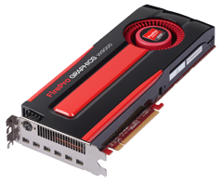
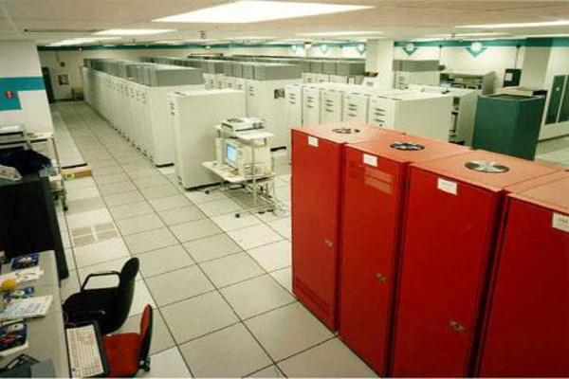
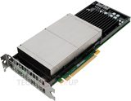
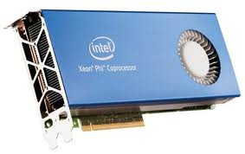
What does 1 TFLOPs Look Like?
2002: Row
2012: Card
1997: Room
AMD FirePro W9000^{[14]}
ASCI RED^{[13]}
Sandia National Lab
NVIDIA Kepler K20^{[15]}
Chip?
Maybe 2016/17
boomer.oscer.ou.edu
In service 2002-5: 11 racks
http://en.wikipedia.org/wiki/Skylake_(microarchitecture)#Release_timing
Intel MIC Xeon PHI^{[16]}

Slide 69
Why Bother?

Slide 70
Why Bother with HPC at All?
It’s clear that making effective use of HPC takes quite a bit of effort, both learning how and developing software.
That seems like a lot of trouble to go to just to get your code to run faster.
It’s nice to have a code that used to take a day, now run in an hour. But if you can afford to wait a day, what’s the point of HPC?
Why go to all that trouble just to get your code to run faster?

Slide 71
Why HPC is Worth the Bother
What HPC gives you that you won’t get elsewhere is the ability to do bigger, better, more exciting science. If your code can run faster, that means that you can tackle much bigger problems in the same amount of time that you used to need for smaller problems.
HPC is important not only for its own sake, but also because what happens in HPC today will be on your desktop in about 10 to 15 years and on your cell phone in 25 years: it puts you ahead of the curve.

Slide 72
The Future is Now
Historically, this has always been true:
Whatever happens in supercomputing today will be on your desktop in 10 – 15 years.
So, if you have experience with supercomputing, you’ll be ahead of the curve when things get to the desktop.

Slide 73
TENTATIVE Schedule
Tue Jan 20: Overview: What the Heck is Supercomputing?
Tue Jan 27: The Tyranny of the Storage Hierarchy
Tue Feb 3: Instruction Level Parallelism
Tue Feb 10: Stupid Compiler Tricks
Tue Feb 17: Shared Memory Multithreading
Tue Feb 24: Distributed Multiprocessing
Tue March 3: Applications and Types of Parallelism
Tue March 10: Multicore Madness
Tue March 17: NO SESSION (OU's Spring Break)
Tue March 24: NO SESSION (Henry has a huge grant proposal due)
Tue March 31: High Throughput Computing
Tue Apr 7: GPGPU: Number Crunching in Your Graphics Card
Tue Apr 14: Grab Bag: Scientific Libraries, I/O Libraries, Visualization

Slide 74
Thanks for helping!
OU IT
  OSCER operations staff (Brandon George, Dave Akin, Brett Zimmerman, Josh Alexander, Patrick Calhoun)
  Horst Severini, OSCER Associate Director for Remote & Heterogeneous Computing
  Debi Gentis, OSCER Coordinator
  Jim Summers
  The OU IT network team
James Deaton, Skyler Donahue, Jeremy Wright and Steven Haldeman, OneNet
Kay Avila, U Iowa
Stephen Harrell, Purdue U

Slide 75
Coming in 2015!
Red Hat Tech Day, Thu Jan 22 2015 @ OU
http://goo.gl/forms/jORZCz9xh7
Linux Clusters Institute workshop May 18-22 2015 @ OU
http://www.linuxclustersinstitute.org/workshops/
Great Plains Network Annual Meeting, May 27-29, Kansas City
Advanced Cyberinfrastructure Research & Education Facilitators (ACI-REF) Virtual Residency May 31 - June 6 2015
XSEDE2015, July 26-30, St. Louis MO
https://conferences.xsede.org/xsede15
IEEE Cluster 2015, Sep 23-27, Chicago IL
http://www.mcs.anl.gov/ieeecluster2015/
OKLAHOMA SUPERCOMPUTING SYMPOSIUM 2015, Sep 22-23 2015 @ OU
SC13, Nov 15-20 2015, Austin TX
http://sc15.supercomputing.org/

Slide 76
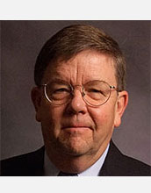

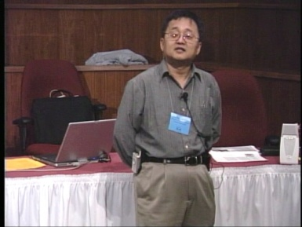
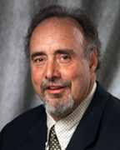
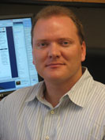
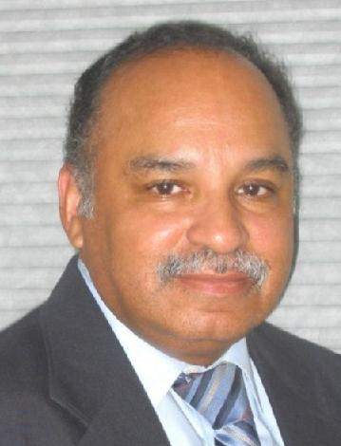
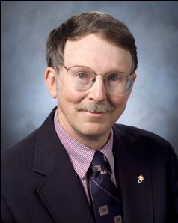
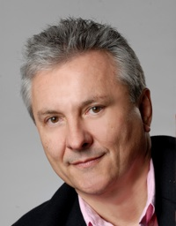
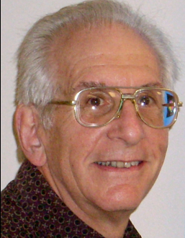
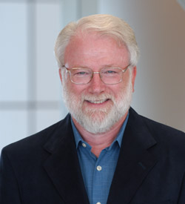

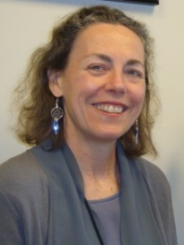
OK Supercomputing Symposium 2015
2003 Keynote:
Peter Freeman
NSF
Computer & Information
Science & Engineering
Assistant Director
2004 Keynote:
Sangtae Kim
NSF Shared
Cyberinfrastructure
Division Director
2005 Keynote:
Walt Brooks
NASA Advanced
Supercomputing
Division Director
2006 Keynote:
Dan Atkins
Head of NSF’s
Office of
Cyberinfrastructure
2007 Keynote:
Jay Boisseau
Director
Texas Advanced
Computing Center
U. Texas Austin
2008 Keynote: José Munoz Deputy Office Director/Senior Scientific Advisor NSF Office of Cyberinfrastructure
2009 Keynote: Douglass Post Chief Scientist US Dept of Defense HPC Modernization Program
FREE!
Wed Sep 23 2015
@ OU
Over 235 registra2ons already!
Over 152 inhe first day, over 200 in the first week, over 225 in the first month.
2011 Keynote: Barry Schneider Program Manager National Science Foundation
2012 Keynote: Thom Dunning Director National Center for Supercomputing Applications
2014 Keynote: Irene Qualters Division Director Advanced Cyberinfarstructure Division, NSF
Reception/Poster Session
Tue Sep 22 2015 @ OU
Symposium
Wed Sep 23 2015 @ OU
2010 Keynote: Horst Simon Deputy Director Lawrence Berkeley National Laboratory
2013 Keynote: John Shalf Dept Head CS Lawrence Berkeley Lab CTO, NERSC

Slide 77
Thanks for your attention!
Questions? www.oscer.ou.edu

Slide 78
References
[1] Image by Greg Bryan, Columbia U.
[2] “Update on the Collaborative Radar Acquisition Field Test (CRAFT): Planning for the Next Steps.”
Presented to NWS Headquarters August 30 2001.
[3] See http://hneeman.oscer.ou.edu/hamr.html for details.
[4] http://www.dell.com/
[5] http://www.vw.com/newbeetle/
[6] Richard Gerber, The Software Optimization Cookbook: High-performance Recipes for the Intel Architecture. Intel Press, 2002, pp. 161-168.
[7] RightMark Memory Analyzer. http://cpu.rightmark.org/
[8] ftp://download.intel.com/design/Pentium4/papers/24943801.pdf
[9] http://www.samsungssd.com/meetssd/techspecs
[10] http://www.samsung.com/Products/OpticalDiscDrive/SlimDrive/OpticalDiscDrive_SlimDrive_SN_S082D.asp?page=Specifications
[11] ftp://download.intel.com/design/Pentium4/manuals/24896606.pdf
[12] http://www.pricewatch.com/

