Slide 1




Supercomputing in Plain English
Multicore Madness
Henry Neeman, Director
OU Supercomputing Center for Education & Research (OSCER)
University of Oklahoma
Tuesday March 12 2013

Slide 2
This is an experiment!
It’s the nature of these kinds of videoconferences that FAILURES ARE GUARANTEED TO HAPPEN! NO PROMISES!
So, please bear with us. Hopefully everything will work out well enough.
If you lose your connection, you can retry the same kind of connection, or try connecting another way.
Remember, if all else fails, you always have the toll free phone bridge to fall back on.

Slide 3
H.323 (Polycom etc) #1
If you want to use H.323 videoconferencing – for example, Polycom – then:
If you AREN’T registered with the OneNet gatekeeper (which is probably the case), then:
  Dial 164.58.250.47
  Bring up the virtual keypad.
  On some H.323 devices, you can bring up the virtual keypad by typing:
  #
  (You may want to try without first, then with; some devices won't work with the #, but give cryptic error messages about it.)
  When asked for the conference ID, or if there's no response, enter:
  0409
  On most but not all H.323 devices, you indicate the end of the ID with:
  #

Slide 4
H.323 (Polycom etc) #2
If you want to use H.323 videoconferencing – for example, Polycom – then:
If you ARE already registered with the OneNet gatekeeper (most institutions aren’t), dial:
2500409
Many thanks to Skyler Donahue and Steven Haldeman of OneNet for providing this.

Slide 5
Wowza #1
You can watch from a Windows, MacOS or Linux laptop using Wowza from either of the following URLs:
http://www.onenet.net/technical-resources/video/sipe-stream/
OR
https://vcenter.njvid.net/videos/livestreams/page1/
Wowza behaves a lot like YouTube, except live.
Many thanks to Skyler Donahue and Steven Haldeman of OneNet and Bob Gerdes of Rutgers U for providing this.

Slide 6
Wowza #2
Wowza has been tested on multiple browsers on each of:
Windows (7 and 8): IE, Firefox, Chrome, Opera, Safari
MacOS X: Safari, Firefox
Linux: Firefox, Opera
We’ve also successfully tested it on devices with:
Android
iOS
However, we make no representations on the likelihood of it working on your device, because we don’t know which versions of Android or iOS it might or might not work with.

Slide 7
Wowza #3
If one of the Wowza URLs fails, try switching over to the other one.
If we lose our network connection between OU and OneNet, then there may be a slight delay while we set up a direct connection to Rutgers.

Slide 8
Toll Free Phone Bridge
IF ALL ELSE FAILS, you can use our toll free phone bridge:
800-832-0736
* 623 2847 #
Please mute yourself and use the phone to listen.
Don’t worry, we’ll call out slide numbers as we go.
Please use the phone bridge ONLY if you cannot connect any other way: the phone bridge can handle only 100 simultaneous connections, and we have over 350 participants.
Many thanks to OU CIO Loretta Early for providing the toll free phone bridge.

Slide 9
Please Mute Yourself
No matter how you connect, please mute yourself, so that we cannot hear you.
(For Wowza, you don’t need to do that, because the information only goes from us to you, not from you to us.)
At OU, we will turn off the sound on all conferencing technologies.
That way, we won’t have problems with echo cancellation.
Of course, that means we cannot hear questions.
So for questions, you’ll need to send e-mail.

Slide 10
Questions via E-mail Only
Ask questions by sending e-mail to:
sipe2013@gmail.com
All questions will be read out loud and then answered out loud.

Slide 11
TENTATIVE Schedule
Tue Jan 22: Overview: What the Heck is Supercomputing?
Tue Jan 29: The Tyranny of the Storage Hierarchy
Tue Feb 5: Instruction Level Parallelism
Tue Feb 12: Stupid Compiler Tricks
Tue Feb 19: Shared Memory Multithreading
Tue Feb 26: Distributed Multiprocessing
Tue March 5: Applications and Types of Parallelism
Tue March 12: Multicore Madness
Tue March 19: NO SESSION (OU's Spring Break)
Tue March 26: High Throughput Computing
Tue Apr 2: GPGPU: Number Crunching in Your Graphics Card
Tue Apr 9: Grab Bag: Scientific Libraries, I/O Libraries, Visualization

Slide 12
Supercomputing Exercises #1
Want to do the “Supercomputing in Plain English” exercises?
The 3rd exercise will be posted soon at:
http://www.oscer.ou.edu/education/
If you don’t yet have a supercomputer account, you can get a temporary account, just for the “Supercomputing in Plain English” exercises, by sending e-mail to:
hneeman@ou.edu
Please note that this account is for doing the exercises only, and will be shut down at the end of the series. It’s also available only to those at institutions in the USA.
This week’s Introductory exercise will teach you how to compile and run jobs on OU’s big Linux cluster supercomputer, which is named Boomer.

Slide 13
Supercomputing Exercises #2
You’ll be doing the exercises on your own (or you can work with others at your local institution if you like).
These aren’t graded, but we’re available for questions:
hneeman@ou.edu

Slide 14
Thanks for helping!
OU IT
  OSCER operations staff (Brandon George, Dave Akin, Brett Zimmerman, Josh Alexander, Patrick Calhoun)
  Horst Severini, OSCER Associate Director for Remote & Heterogeneous Computing
  Debi Gentis, OU Research IT coordinator
  Kevin Blake, OU IT (videographer)
  Chris Kobza, OU IT (learning technologies)
  Mark McAvoy
Kyle Keys, OU National Weather Center
James Deaton, Skyler Donahue and Steven Haldeman, OneNet
Bob Gerdes, Rutgers U
Lisa Ison, U Kentucky
Paul Dave, U Chicago

Slide 15
This is an experiment!
It’s the nature of these kinds of videoconferences that FAILURES ARE GUARANTEED TO HAPPEN! NO PROMISES!
So, please bear with us. Hopefully everything will work out well enough.
If you lose your connection, you can retry the same kind of connection, or try connecting another way.
Remember, if all else fails, you always have the toll free phone bridge to fall back on.

Slide 16
Coming in 2013!
From Computational Biophysics to Systems Biology, May 19-21, Norman OK
Great Plains Network Annual Meeting, May 29-31, Kansas City
XSEDE2013, July 22-25, San Diego CA
IEEE Cluster 2013, Sep 23-27, Indianapolis IN
OKLAHOMA SUPERCOMPUTING SYMPOSIUM 2013, Oct 1-2, Norman OK
SC13, Nov 17-22, Denver CO

Slide 17
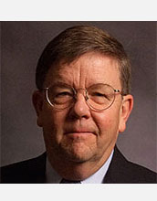
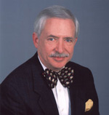
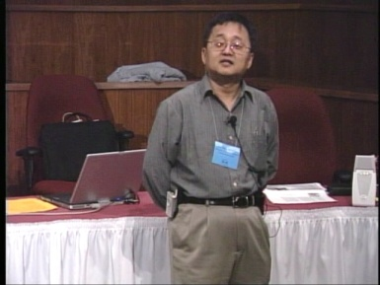
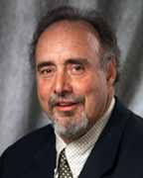
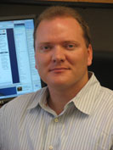
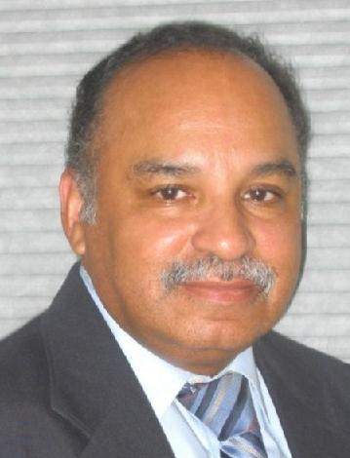
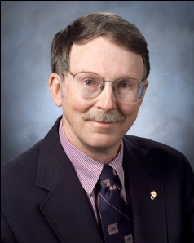
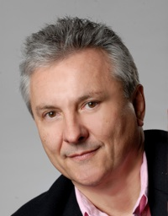
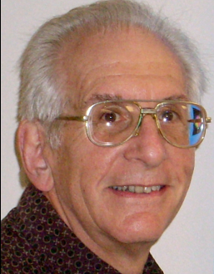
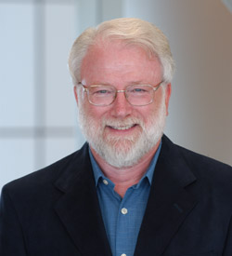
OK Supercomputing Symposium 2013
2003 Keynote:
Peter Freeman
NSF
Computer & Information
Science & Engineering
Assistant Director
2004 Keynote:
Sangtae Kim
NSF Shared
Cyberinfrastructure
Division Director
2005 Keynote:
Walt Brooks
NASA Advanced
Supercomputing
Division Director
2006 Keynote:
Dan Atkins
Head of NSF’s
Office of
Cyberinfrastructure
2007 Keynote:
Jay Boisseau
Director
Texas Advanced
Computing Center
U. Texas Austin
2008 Keynote: José Munoz Deputy Office Director/ Senior Scientific Advisor NSF Office of Cyberinfrastructure
2013 Keynote to be announced!
2009 Keynote: Douglass Post Chief Scientist US Dept of Defense HPC Modernization Program
2010 Keynote: Horst Simon Deputy Director Lawrence Berkeley National Laboratory
FREE! Wed Oct 2 2013 @ OU
Over 235 registra2ons already!
Over 150 in the first day, over 200 in the first week, over 225 in the first month.
2011 Keynote: Barry Schneider Program Manager National Science Foundation
2012 Keynote: Thom Dunning Director National Center for Supercomputing Applications
http://symposium2013.oscer.ou.edu/
Reception/Poster Session
Tue Oct 1 2013 @ OU
Symposium Wed Oct 2 2013 @ OU

Slide 18
Outline
The March of Progress
Multicore/Many-core Basics
Software Strategies for Multicore/Many-core
A Concrete Example: Weather Forecasting

Slide 19
The March of Progress

Slide 20
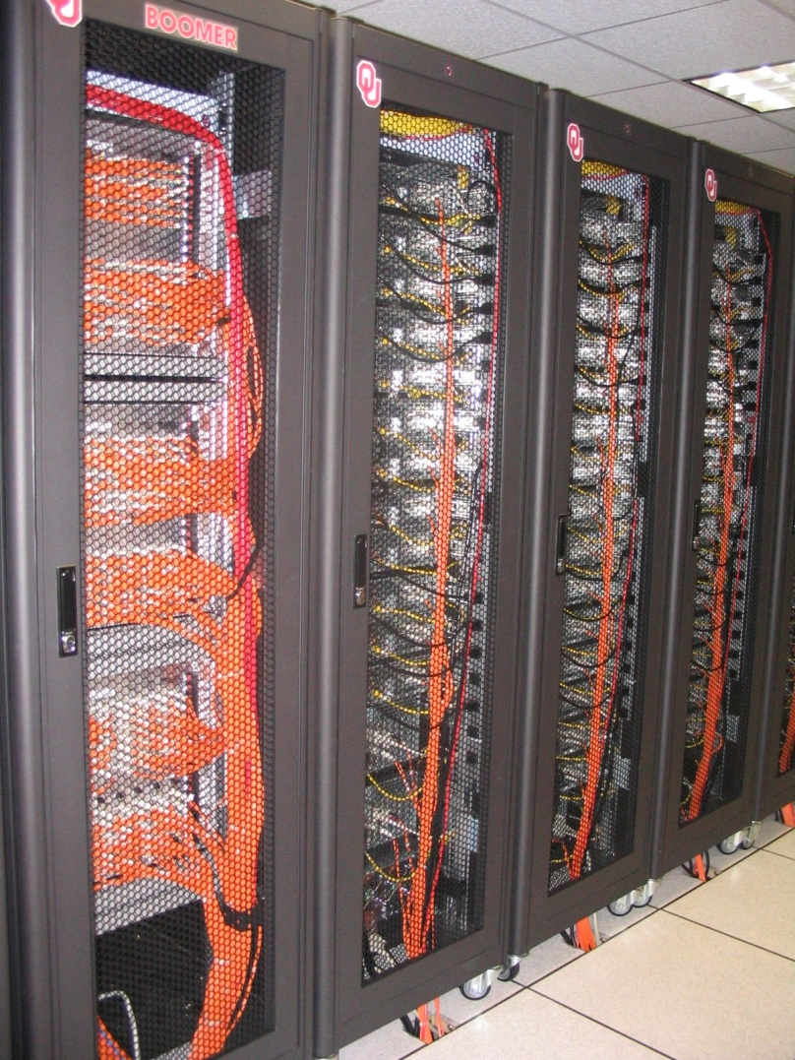

OU’s TeraFLOP Cluster, 2002
10 racks @ 1000 lbs per rack
270 Pentium4 Xeon CPUs, 2.0 GHz, 512 KB L2 cache
270 GB RAM, 400 MHz FSB
8 TB disk
Myrinet2000 Interconnect
100 Mbps Ethernet Interconnect
OS: Red Hat Linux
Peak speed: 1.08 TFLOPs
(1.08 trillion calculations per second)
One of the first Pentium4 clusters!
boomer.oscer.ou.edu

Slide 21
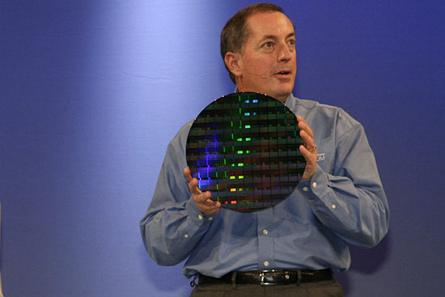
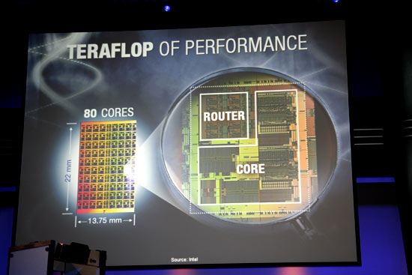
TeraFLOP, Prototype 2006
4 years from room to research chip!
http://news.com.com/2300-1006_3-6119652.html

Slide 22

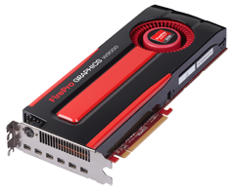
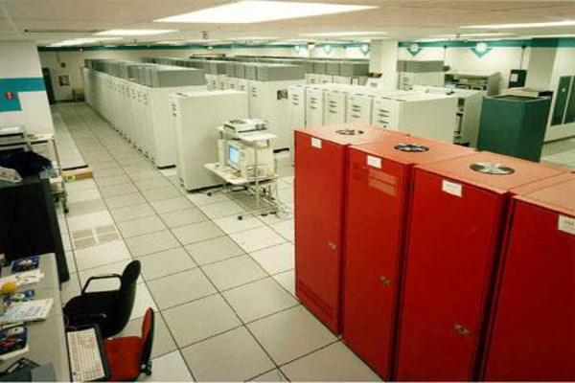
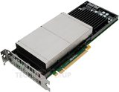
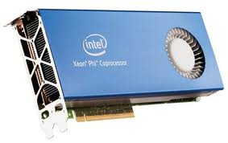
What does 1 TFLOPs Look Like?
2002: Row
2012: Card
1997: Room
AMD FirePro W9000^{[14]}
ASCI RED^{[13]}
Sandia National Lab
NVIDIA Kepler K20^{[15]}
boomer.oscer.ou.edu
In service 2002-5: 11 racks
Intel MIC Xeon PHI^{[16]}

Slide 23
Moore’s Law
In 1965, Gordon Moore was an engineer at Fairchild Semiconductor.
He noticed that the number of transistors that could be squeezed onto a chip was doubling about every 18 months.
It turns out that computer speed is roughly proportional to the number of transistors per unit area.
Moore wrote a paper about this concept, which became known as “Moore’s Law.”

Slide 24
Moore’s Law in Practice
CPU
log(Speed)
Year

Slide 25
Moore’s Law in Practice
Network Bandwidth
CPU
log(Speed)
Year

Slide 26
Moore’s Law in Practice
Network Bandwidth
CPU
log(Speed)
RAM
Year

Slide 27
Moore’s Law in Practice
Network Bandwidth
log(Speed)
CPU
RAM
1/Network Latency
Year

Slide 28
Moore’s Law in Practice
Network Bandwidth
CPU
log(Speed)
RAM
1/Network Latency
Software
Year

Slide 29
Fastest Supercomputer vs. Moore
Speed in GFLOPs
GFLOPs:
billions of calculations per second
1993: 1024 CPU cores
Year

Slide 30
The Tyranny of the Storage Hierarchy

Slide 31
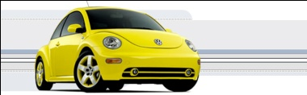
The Storage Hierarchy
Fast, expensive, few
Registers
Cache memory
Main memory (RAM)
Hard disk
Removable media (CD, DVD etc)
Internet
Slow, cheap, a lot
[5]

Slide 32

RAM is Slow
CPU
307 GB/sec^{[6]}
The speed of data transfer
between Main Memory and the
CPU is much slower than the
speed of calculating, so the CPU
spends most of its time waiting
for data to come in or go out.
Bottleneck
4.4 GB/sec^{[7]} (1.4%)

Slide 33
Why Have Cache?
CPU
Cache is much closer to the speed
of the CPU, so the CPU doesn’t
have to wait nearly as long for
stuff that’s already in cache:
it can do more
operations per second!
27 GB/sec (9%)^{[7]}
4.4 GB/sec^{[7]} (1%)

Slide 34
A Laptop
Dell Latitude Z600^{[4]}
Intel Core2 Duo SU9600 1.6 GHz w/3 MB L2 Cache
4 GB 1066 MHz DDR3 SDRAM
256 GB SSD Hard Drive
DVD+RW/CD-RW Drive (8x)
1 Gbps Ethernet Adapter

Slide 35
Storage Speed, Size, Cost
Laptop | Registers (Intel Core2 Duo 1.6 GHz) | Cache Memory (L2) | Main Memory (1066MHz DDR3 SDRAM) | Hard Drive (SSD) | Ethernet (1000 Mbps) | DVD+R (16x) | Phone Modem (56 Kbps)
Speed (MB/sec) [peak] | 314,573^{[6]} (12,800 MFLOP/s*) | 27,276 ^{[7]} | 4500 ^{[7]} | 250 ^{[9]} | 125 | 22 ^{[10]} | 0.007
Size (MB) | 464 bytes** ^{[11]} | 3 | 4096 | 256,000 | unlimited | unlimited | unlimited
Cost ($/MB) | – | $285 ^{[13]} | $0.03 ^{[12]} | $0.002 ^{[12]} | charged per month (typically) | $0.00005 ^{[12]} | charged per month (typically)
* MFLOP/s: millions of floating point operations per second
** 16 64-bit general purpose registers, 8 80-bit floating point registers,
16 128-bit floating point vector registers

Slide 36
Storage Use Strategies
Register reuse: Do a lot of work on the same data before working on new data.
Cache reuse: The program is much more efficient if all of the data and instructions fit in cache; if not, try to use what’s in cache a lot before using anything that isn’t in cache.
Data locality: Try to access data that are near each other in memory before data that are far.
I/O efficiency: Do a bunch of I/O all at once rather than a little bit at a time; don’t mix calculations and I/O.

Slide 37
A Concrete Example
Consider a cluster with Sandy Bridge CPUs: oct core, 2.0 GHz, 1333 MHz quad channel QPI.
The theoretical peak CPU speed is 128 GFLOPs (double precision) per CPU chip, and in practice the benchmark per core as 89% of that (100+% for a single core due to automatic overclocking). For a dual chip node, the peak is 256 GFLOPs.
Each double precision calculation is 2 8-byte operands and one 8-byte result, so 24 bytes get moved between RAM and CPU.
So, in theory each node could consume up to 5722 GB/sec.
The sustained RAM bandwidth is around 60-70 GB/sec.
So, even at theoretical peak, any code that does less than around 80 calculations per byte transferred between RAM and cache has speed limited by RAM bandwidth.

Slide 38
Good Cache Reuse Example

Slide 39
A Sample Application
Matrix-Matrix Multiply
Let A, B and C be matrices of sizes
nr × nc, nr × nk and nk × nc, respectively:
The definition of A = B • C is
for r ∈ {1, nr}, c ∈ {1, nc}.

Slide 40
Matrix Multiply: Naïve Version
SUBROUTINE matrix_matrix_mult_naive (dst, src1, src2, &
& nr, nc, nq)
IMPLICIT NONE
INTEGER,INTENT(IN) :: nr, nc, nq
REAL,DIMENSION(nr,nc),INTENT(OUT) :: dst
REAL,DIMENSION(nr,nq),INTENT(IN) :: src1
REAL,DIMENSION(nq,nc),INTENT(IN) :: src2
INTEGER :: r, c, q
DO c = 1, nc
DO r = 1, nr
dst(r,c) = 0.0
DO q = 1, nq
dst(r,c) = dst(r,c) + src1(r,q) * src2(q,c)
END DO
END DO
END DO
END SUBROUTINE matrix_matrix_mult_naive

Slide 41
Performance of Matrix Multiply
Better

Slide 42
Tiling

Slide 43
Tiling
Tile: A small rectangular subdomain of a problem domain. Sometimes called a block or a chunk.
Tiling: Breaking the domain into tiles.
Tiling strategy: Operate on each tile to completion, then move to the next tile.
Tile size can be set at runtime, according to what’s best for the machine that you’re running on.

Slide 44
Tiling Code
SUBROUTINE matrix_matrix_mult_by_tiling (dst, src1, src2, nr, nc, nq, &
& rtilesize, ctilesize, qtilesize)
IMPLICIT NONE
INTEGER,INTENT(IN) :: nr, nc, nq
REAL,DIMENSION(nr,nc),INTENT(OUT) :: dst
REAL,DIMENSION(nr,nq),INTENT(IN) :: src1
REAL,DIMENSION(nq,nc),INTENT(IN) :: src2
INTEGER,INTENT(IN) :: rtilesize, ctilesize, qtilesize
INTEGER :: rstart, rend, cstart, cend, qstart, qend
DO cstart = 1, nc, ctilesize
cend = cstart + ctilesize - 1
IF (cend > nc) cend = nc
DO rstart = 1, nr, rtilesize
rend = rstart + rtilesize - 1
IF (rend > nr) rend = nr
DO qstart = 1, nq, qtilesize
qend = qstart + qtilesize - 1
IF (qend > nq) qend = nq
CALL matrix_matrix_mult_tile(dst, src1, src2, nr, nc, nq, &
& rstart, rend, cstart, cend, qstart, qend)
END DO
END DO
END DO
END SUBROUTINE matrix_matrix_mult_by_tiling

Slide 45
Multiplying Within a Tile
SUBROUTINE matrix_matrix_mult_tile (dst, src1, src2, nr, nc, nq, &
& rstart, rend, cstart, cend, qstart, qend)
IMPLICIT NONE
INTEGER,INTENT(IN) :: nr, nc, nq
REAL,DIMENSION(nr,nc),INTENT(OUT) :: dst
REAL,DIMENSION(nr,nq),INTENT(IN) :: src1
REAL,DIMENSION(nq,nc),INTENT(IN) :: src2
INTEGER,INTENT(IN) :: rstart, rend, cstart, cend, qstart, qend
INTEGER :: r, c, q
DO c = cstart, cend
DO r = rstart, rend
IF (qstart == 1) dst(r,c) = 0.0
DO q = qstart, qend
dst(r,c) = dst(r,c) + src1(r,q) * src2(q,c)
END DO
END DO
END DO
END SUBROUTINE matrix_matrix_mult_tile

Slide 46
Reminder: Naïve Version, Again
SUBROUTINE matrix_matrix_mult_naive (dst, src1, src2, &
& nr, nc, nq)
IMPLICIT NONE
INTEGER,INTENT(IN) :: nr, nc, nq
REAL,DIMENSION(nr,nc),INTENT(OUT) :: dst
REAL,DIMENSION(nr,nq),INTENT(IN) :: src1
REAL,DIMENSION(nq,nc),INTENT(IN) :: src2
INTEGER :: r, c, q
DO c = 1, nc
DO r = 1, nr
dst(r,c) = 0.0
DO q = 1, nq
dst(r,c) = dst(r,c) + src1(r,q) * src2(q,c)
END DO
END DO
END DO
END SUBROUTINE matrix_matrix_mult_naive

Slide 47
Performance with Tiling
Better

Slide 48
The Advantages of Tiling
It allows your code to exploit data locality better, to get much more cache reuse: your code runs faster!
It’s a relatively modest amount of extra coding (typically a few wrapper functions and some changes to loop bounds).
If you don’t need tiling – because of the hardware, the compiler or the problem size – then you can turn it off by simply setting the tile size equal to the problem size.

Slide 49
Why Does Tiling Work Here?
Cache optimization works best when the number of calculations per byte is large.
For example, with matrix-matrix multiply on an n × n matrix, there are O(n³) calculations (on the order of n³), but only O(n²) bytes of data.
So, for large n, there are a huge number of calculations per byte transferred between RAM and cache.

Slide 50
Will Tiling Always Work?
Tiling WON’T always work. Why?
Well, tiling works well when:
the order in which calculations occur doesn’t matter much, AND
there are lots and lots of calculations to do for each memory movement.
If either condition is absent, then tiling won’t help.

Slide 51
Multicore/Many-core Basics

Slide 52
What is Multicore?
In the olden days (that is, the first half of 2005), each CPU chip had one “brain” in it.
Starting the second half of 2005, each CPU chip could have up to 2 cores (brains); starting in late 2006, 4 cores; starting in late 2008, 6 cores; in early 2010, 8 cores; in mid 2010, 12 cores; in 2011, 16 cores (AMD).
Jargon: Each CPU chip plugs into a socket, so these days, to avoid confusion, people refer to sockets and cores, rather than CPUs or processors.
Each core is just like a full blown CPU, except that it shares its socket (and maybe some of its cache) with one or more other cores – and therefore shares its bandwidth to RAM with them.

Slide 53
Dual Core
Core Core

Slide 54
Quad Core
Core Core
Core Core

Slide 55
Oct Core
Core Core Core Core
Core Core Core Core

Slide 56
The Challenge of Multicore: RAM
Each socket has access to a certain amount of RAM, at a fixed RAM bandwidth per SOCKET – or even per node.
As the number of cores per socket increases, the contention for RAM bandwidth increases too.
At 2 or even 4 cores in a socket, this problem isn’t too bad. But at 16 or 32 or 80 cores, it can become a huge problem.
So, applications that are cache optimized will get big speedups.
But, applications whose performance is limited by RAM bandwidth are going to speed up only as fast as RAM bandwidth speeds up.
RAM bandwidth speeds up much slower than CPU speeds up.

Slide 57
The Challenge of Multicore: Network
Each node has access to a certain number of network ports, at a fixed number of network ports per NODE.
As the number of cores per node increases, the contention for network ports increases too.
At 2 or 4 cores in a socket, this problem isn’t too bad. But at 16 or 32 or 80 cores, it can be a huge problem.
So, applications that do minimal communication will get big speedups.
But, applications whose performance is limited by the number of MPI messages are going to speed up very very little – and may even crash the node.

Slide 58
A Concrete Example:
Weather Forecasting

Slide 59
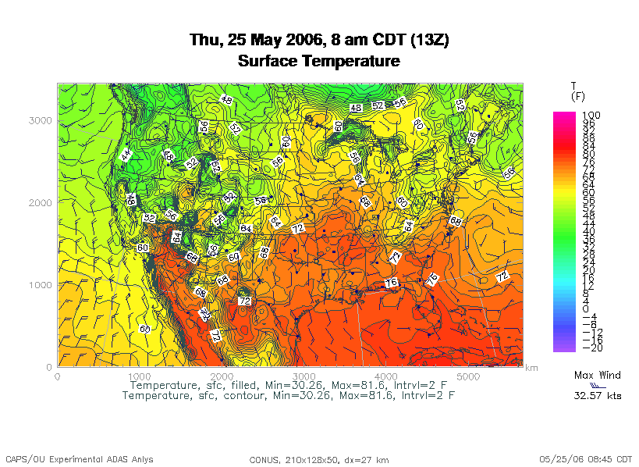
Weather Forecasting
http://www.caps.ou.edu/wx/p/r/conus/fcst/

Slide 60
Weather Forecasting
Weather forecasting is a transport problem.
The goal is to predict future weather conditions by simulating the movement of fluids in Earth’s atmosphere.
The physics is the Navier-Stokes Equations.
The numerical method is Finite Difference.

Slide 61
Cartesian Mesh

Slide 62
Finite Difference
unew(i,j,k) = F(uold, i, j, k, Δt) =
F(uold(i,j,k),
uold(i-1,j,k), uold(i+1,j,k),
uold(i,j-1,k), uold(i,j+1,k),
uold(i,j,k-1), uold(i,j,k+1), Δt)

Slide 63
Ghost Boundary Zones

Slide 64
Virtual Memory

Slide 65
Virtual Memory
Typically, the amount of main memory (RAM) that a CPU can address is larger than the amount of data physically present in the computer.
For example, consider a laptop that can address 16 GB of main memory (roughly 16 billion bytes), but only contains 2 GB (roughly 2 billion bytes).
Supercomputing in Plain English: Multicore
Tue March 12 2013

Slide 66
Virtual Memory (cont’d)
Locality: Most programs don’t jump all over the memory that they use; instead, they work in a particular area of memory for a while, then move to another area.
So, you can offload onto hard disk much of the memory image of a program that’s running.
Supercomputing in Plain English: Multicore
Tue March 12 2013

Slide 67
Virtual Memory (cont’d)
Memory is chopped up into many pages of modest size (e.g., 1 KB – 32 KB; typically 4 KB).
Only pages that have been recently used actually reside in memory; the rest are stored on hard disk.
Hard disk is typically 0.1% as fast as main memory, so you get better performance if you rarely get a page fault, which forces a read from (and maybe a write to) hard disk: exploit data locality!
Supercomputing in Plain English: Multicore
Tue March 12 2013

Slide 68
Cache vs. Virtual Memory
Lines (cache) vs. pages (VM)
Cache faster than RAM (cache) vs. RAM faster than disk (VM)
Supercomputing in Plain English: Multicore
Tue March 12 2013

Slide 69
Virtual Memory
Every CPU family today uses virtual memory, in which disk pretends to be a bigger RAM.
Virtual memory capability can’t be turned off (though you can turn off the ability to swap to disk).
RAM is split up into pages, typically 4 KB each.
Each page is either in RAM or out on disk.
To keep track of the pages, a page table notes whether each table is in RAM, where it is in RAM (that is, physical address and virtual address are different), and some other information.
So, a 4 GB physical RAM would need over a million page table entries – and a 32 GB physical RAM as on Boomer would need over 32M page table entries.

Slide 70
Why Virtual Memory is Slow
When you want to access a byte of memory, you have to find out whether it’s in physical memory (RAM) or virtual disk (disk) – and the page table is in RAM!
A page table of a 32 million entries can’t fit in, for example, the 20 MB cache L3 cache on Boomer CPU chips – and even if it could, that wouldn’t leave much cache for actual data.
So, each memory access (load or store) is actually 2 memory accesses: the first for the page table entry, and the second for the data itself.
This is slow!
And notice, this is assuming that you don’t need more memory than your physical RAM.

Slide 71
The Notorious T.L.B.
To speed up memory accesses, CPUs today have a special cache just for page table entries, known as the Translation Lookaside Buffer (TLB).
The size of TLBs varies from 64 entries to 1024 entries, depending on chip families. At 4 KB pages, this means that the size of cache covered by the TLB varies from 256 KB to 4 MB.
Some TLBs allow large pages (1 MB to a few GB) – but the operating systems often provide poor or no support.

Slide 72
The T.L.B. on a Current Chip
On Intel Sandy Bridge, specifically E5-2650 (e.g., on Boomer):
L3 cache size is 20 MB, shared among 8 cores.
L2 cache size is 256 KB per core (dedicated to that core).
Page size can be 4 KB or 2 MB/4 MB or 1 GB.
Data TLB (DTLB) per core is:
  64 entries for 4 KB pages, covering 256 KB per core, OR
  32 entries for 2 MB/4 MB pages, covering 128 MB per core, OR
  4 entries for 1 GB pages, covering 4 GB per core.
DTLB is 4-way set associative.
Shared TLB (STLB), containing a second level of both instruction and data TLB, for the whole chip is:
  512 entries for 4 KB pages, covering 2 MB.
A page table failure can cause a delay of hundreds of cycles.
(This information is from [13].)

Slide 73
The T.L.B. on a Recent Chip
On Intel Sandy Bridge, specifically E5-2650 (e.g., on Boomer):
L3 cache size is 20 MB.
Page size is 4 KB or 2 MB/4 MB or 1 GB.
DTLB in 4 KB mode only covers up to 256 KB cache per core (2 MB total over 8 cores).
Mesh: At 100 vertical levels of 150 single precision variables, 2 MB is a 5 x 5 horizontal domain – almost nothing but ghost zones!
The cost of a TLB miss can be hundreds of cycles, equivalent to hundreds or thousands of calculations!

Slide 74
Software Strategies for Weather Forecasting on Multicore/Many-core

Slide 75
Tiling NOT Good for Weather Codes
Weather codes typically have on the order of 150 3D arrays used in each timestep (some transferred multiple times in the same timestep, but let’s ignore that for simplicity).
These arrays typically are single precision (4 bytes per floating point value).
So, a typical weather code uses about 600 bytes per mesh zone per timestep.
Weather codes typically do 5,000 to 10,000 calculations per mesh zone per timestep.
So, the ratio of calculations to data is less than 20 to 1 – much less than the ~80 to 1 needed (on 2012 hardware).

Slide 76
Weather Forecasting and Cache
On current weather codes, data decomposition is per process. That is, each process gets one subdomain.
As CPUs speed up and RAM sizes grow, the size of each processor’s subdomain grows too.
However, given RAM bandwidth limitations, this means that performance can only grow with RAM speed – which increases slower than CPU speed.
If the codes were optimized for cache, would they speed up more?
First: How to optimize for cache?

Slide 77
How to Get Good Cache Reuse?
Multiple independent subdomains per processor.
Each subdomain fits entirely in L3 cache.
Each subdomain’s page table entries fit entirely in the TLB.
Expanded ghost zone stencil allows multiple timesteps before communicating with neighboring subdomains.
Parallelize along the Z-axis as well as X and Y.
Use higher order numerical schemes.
Reduce the memory footprint as much as possible.
Coincidentally, this also reduces communication cost.

Slide 78
Cache Optimization Strategy: Tiling?
Would tiling work as a cache optimization strategy for weather forecasting codes?

Slide 79
Multiple Subdomains Per Core
Core 0
Core 2
Core 3
Core 1

Slide 80
Why Multiple Subdomains?
If each subdomain fits in cache, then the CPU can bring all the data of a subdomain into cache, chew on it for a while, then move on to the next subdomain: lots of cache reuse!
Oh, wait, what about the TLB? Better make the subdomains smaller! (So more of them.)
But, doesn’t tiling have the same effect?

Slide 81
Why Independent Subdomains?
Originally, the point of this strategy was to hide the cost of communication.
When you finish chewing up a subdomain, send its data to its neighbors non-blocking (MPI_Isend).
While the subdomain’s data is flying through the interconnect, work on other subdomains, which hides the communication cost.
When it’s time to work on this subdomain again, collect its data (MPI_Waitall).
If you’ve done enough work, then the communication cost is zero.

Slide 82
Expand the Array Stencil
If you expand the array stencil of each subdomain beyond the numerical stencil, then you don’t have to communicate as often.
When you communicate, instead of sending a slice along each face, send a slab, with extra stencil levels.
In the first timestep after communicating, do extra calculations out to just inside the numerical stencil.
In subsequent timesteps, calculate fewer and fewer stencil levels, until it’s time to communicate again – less total communication, and more calculations to hide the communication cost underneath!

Slide 83
An Extra Win!
If you do all this, there’s an amazing side effect: you get better cache reuse, because you stick with the same subdomain for a longer period of time.
So, instead of doing, say, 5000 calculations per zone per timestep, you can do 15000 or 20000.
So, you can better amortize the cost of transferring the data between RAM and cache.
Downside: ratio of ghost zone RAM use to computed zone RAM use gets worse.
  But RAM is cheap.

Slide 84
New Algorithm (F90)
DO timestep = 1, number_of_timesteps, extra_stencil_levels
DO subdomain = 1, number_of_local_subdomains
CALL receive_messages_nonblocking(subdomain, timestep)
DO extra_stencil_level = 0, extra_stencil_levels - 1
CALL calculate_entire_timestep(subdomain,
timestep + extra_stencil_level)
END DO
CALL send_messages_nonblocking(subdomain,
timestep + extra_stencil_levels)
` END DO
END DO

Slide 85
New Algorithm (C)
for (timestep = 0;
timestep < number_of_timesteps;
timestep += extra_stencil_levels) {
for (subdomain = 0;
subdomain < number_of_local_subdomains; subdomain++) {
receive_messages_nonblocking(subdomain, timestep);
for (extra_stencil_level = 0;
extra_stencil_level < extra_stencil_levels;
extra_stencil_level++) {
calculate_entire_timestep(subdomain,
timestep + extra_stencil_level);
} /* for extra_stencil_level */
send_messages_nonblocking(subdomain,
timestep + extra_stencil_levels);
} /* for subdomain */
} /* for timestep */

Slide 86
Higher Order Numerical Schemes
Higher order numerical schemes are great, because they require more calculations per mesh zone per timestep, which you need to amortize the cost of transferring data between RAM and cache. Might as well!
Plus, they allow you to use a larger time interval per timestep (dt), so you can do fewer total timesteps for the same accuracy – or you can get higher accuracy for the same number of timesteps.

Slide 87
Parallelize in Z
Most weather forecast codes parallelize in X and Y, but not in Z, because gravity makes the calculations along Z more complicated than X and Y.
But, that means that each subdomain has a high number of zones in Z, compared to X and Y.
For example, a 1 km CONUS run will probably have 100 zones in Z (25 km at 0.25 km resolution).

Slide 88
Multicore/Many-core Problem
Most multicore chip families have relatively small cache per core (for example, 1 - 4 MB per core at the highest/slowest cache level) – and this problem seems likely to remain.
Small TLBs make the problem worse: a few MB per core rather than 10-30 MB.
So, to get good cache reuse, you need subdomains of no more than a few MB.
If you have 150 3D variables at single precision, and 100 zones in Z, then your horizontal size will be 5 x 5 zones – just enough for your stencil!

Slide 89
What Do We Need?
We need much bigger caches!
  16 MB cache ➔ 16 x 16 horizontal including stencil
  32 MB cache ➔ 23 x 23 horizontal including stencil
TLB must be big enough to cover the entire cache.
It’d be nice to have RAM speed increase as fast as core counts increase, but let’s not kid ourselves.
Keep this in mind when we get to GPGPU!

Slide 90
OK Supercomputing Symposium 2013
2003 Keynote:
Peter Freeman
NSF
Computer & Information
Science & Engineering
Assistant Director
2004 Keynote:
Sangtae Kim
NSF Shared
Cyberinfrastructure
Division Director
2005 Keynote:
Walt Brooks
NASA Advanced
Supercomputing
Division Director
2006 Keynote:
Dan Atkins
Head of NSF’s
Office of
Cyberinfrastructure
2007 Keynote:
Jay Boisseau
Director
Texas Advanced
Computing Center
U. Texas Austin
2008 Keynote: José Munoz Deputy Office Director/ Senior Scientific Advisor NSF Office of Cyberinfrastructure
2013 Keynote to be announced!
2009 Keynote: Douglass Post Chief Scientist US Dept of Defense HPC Modernization Program
2010 Keynote: Horst Simon Deputy Director Lawrence Berkeley National Laboratory
FREE! Wed Oct 2 2013 @ OU
Over 235 registra2ons already!
Over 150 in the first day, over 200 in the first week, over 225 in the first month.
2011 Keynote: Barry Schneider Program Manager National Science Foundation
2012 Keynote: Thom Dunning Director National Center for Supercomputing Applications
http://symposium2013.oscer.ou.edu/
Reception/Poster Session
Tue Oct 1 2013 @ OU
Symposium Wed Oct 2 2013 @ OU

Slide 91
Thanks for your attention!
Questions? www.oscer.ou.edu

Slide 92
References
[1] Image by Greg Bryan, Columbia U.
[2] “Update on the Collaborative Radar Acquisition Field Test (CRAFT): Planning for the Next Steps.”
Presented to NWS Headquarters August 30 2001.
[3] See http://hneeman.oscer.ou.edu/hamr.html for details.
[4] http://www.dell.com/
[5] http://www.vw.com/newbeetle/
[6] Richard Gerber, The Software Optimization Cookbook: High-performance Recipes for the Intel Architecture. Intel Press, 2002, pp. 161-168.
[7] RightMark Memory Analyzer. http://cpu.rightmark.org/
[8] ftp://download.intel.com/design/Pentium4/papers/24943801.pdf
[9] http://www.seagate.com/cda/products/discsales/personal/family/0,1085,621,00.html
[10] http://www.samsung.com/Products/OpticalDiscDrive/SlimDrive/OpticalDiscDrive_SlimDrive_SN_S082D.asp?page=Specifications
[11] ftp://download.intel.com/design/Pentium4/manuals/24896606.pdf
[12] http://www.pricewatch.com/
[13] http://www.intel.com/Assets/en_US/PDF/manual/248966.pdf

