Slide 1




Supercomputing in Plain English
GPGPU: Number Crunching in
Your Graphics Card
Henry Neeman, Director
Director, OU Supercomputing Center for Education & Research (OSCER)
Assistant Vice President, Information Technology – Research Strategy Advisor
Associate Professor, College of Engineering
Adjunct Associate Professor, School of Computer Science
University of Oklahoma
Tuesday April 14 2015

Slide 2
This is an experiment!
It’s the nature of these kinds of videoconferences that FAILURES ARE GUARANTEED TO HAPPEN! NO PROMISES!
So, please bear with us. Hopefully everything will work out well enough.
If you lose your connection, you can retry the same kind of connection, or try connecting another way.
Remember, if all else fails, you always have the toll free phone bridge to fall back on.

Slide 3
PLEASE MUTE YOURSELF
No matter how you connect, PLEASE MUTE YOURSELF, so that we cannot hear you.
At OU, we will turn off the sound on all conferencing technologies.
That way, we won’t have problems with echo cancellation.
Of course, that means we cannot hear questions.
So for questions, you’ll need to send e-mail.
PLEASE MUTE YOURSELF.
PLEASE MUTE YOURSELF.

Slide 4
PLEASE REGISTER
If you haven’t already registered, please do so.
You can find the registration link on the SiPE webpage:
http://www.oscer.ou.edu/education/
Our ability to continue providing Supercomputing in Plain English depends on being able to show strong participation.
We use our headcounts, institution counts and state counts (since 2001, over 2000 served, from every US state except RI and VT, plus 17 other countries, on every continent except Australia and Antarctica) to improve grant proposals.

Slide 5
Download the Slides Beforehand
Before the start of the session, please download the slides from the Supercomputing in Plain English website:
http://www.oscer.ou.edu/education/
That way, if anything goes wrong, you can still follow along with just audio.
PLEASE MUTE YOURSELF.

Slide 6
H.323 (Polycom etc) #1
If you want to use H.323 videoconferencing – for example, Polycom – then:
If you AREN’T registered with the OneNet gatekeeper (which is probably the case), then:
  Dial 164.58.250.51
  Bring up the virtual keypad.
  On some H.323 devices, you can bring up the virtual keypad by typing:
  #
  (You may want to try without first, then with; some devices won't work with the #, but give cryptic error messages about it.)
  When asked for the conference ID, or if there's no response, enter:
  0409
  On most but not all H.323 devices, you indicate the end of the ID with:
  #

Slide 7
H.323 (Polycom etc) #2
If you want to use H.323 videoconferencing – for example, Polycom – then:
If you ARE already registered with the OneNet gatekeeper (most institutions aren’t), dial:
2500409
Many thanks to James Deaton, Skyler Donahue, Jeremy Wright and Steven Haldeman of OneNet for providing this.
PLEASE MUTE YOURSELF.

Slide 8
Wowza #1
You can watch from a Windows, MacOS or Linux laptop using Wowza from the following URL:
http://jwplayer.onenet.net/stream6/sipe.html
Wowza behaves a lot like YouTube, except live.
Many thanks to James Deaton, Skyler Donahue, Jeremy Wright and Steven Haldeman of OneNet for providing this.
PLEASE MUTE YOURSELF.

Slide 9
Wowza #2
Wowza has been tested on multiple browsers on each of:
Windows (7 and 8): IE, Firefox, Chrome, Opera, Safari
MacOS X: Safari, Firefox
Linux: Firefox, Opera
We’ve also successfully tested it on devices with:
Android
iOS
However, we make no representations on the likelihood of it working on your device, because we don’t know which versions of Android or iOS it mi
PLEASE MUTE YOURSELF.
ght or might not work with.

Slide 10
RTMP
If you have a video player that can handle RTMP, you can watch the Wowza feed that way:
rtmp://stream3.onenet.net/live/mp4:sipe-wowza

Slide 11
Toll Free Phone Bridge
IF ALL ELSE FAILS, you can use our toll free phone bridge:
800-832-0736
* 623 2874 #
Please mute yourself and use the phone to listen.
Don’t worry, we’ll call out slide numbers as we go.
Please use the phone bridge ONLY if you cannot connect any other way: the phone bridge can handle only 100 simultaneous connections, and we have over 500 participants.
Many thanks to OU CIO Loretta Early for providing the toll free phone bridge.
PLEASE MUTE YOURSELF.

Slide 12
Please Mute Yourself
No matter how you connect, PLEASE MUTE YOURSELF, so that we cannot hear you.
(For Wowza, you don’t need to do that, because the information only goes from us to you, not from you to us.)
At OU, we will turn off the sound on all conferencing technologies.
That way, we won’t have problems with echo cancellation.
Of course, that means we cannot hear questions.
So for questions, you’ll need to send e-mail.
PLEASE MUTE YOURSELF.
PLEASE MUTE YOURSELF.

Slide 13
Questions via E-mail Only
Ask questions by sending e-mail to:
sipe2015@gmail.com
All questions will be read out loud and then answered out loud.
PLEASE MUTE YOURSELF.

Slide 14
Onsite: Talent Release Form
If you’re attending onsite, you MUST do one of the following:
complete and sign the Talent Release Form,
OR
sit behind the cameras (where you can’t be seen) and don’t talk at all.
If you aren’t onsite, then PLEASE MUTE YOURSELF.

Slide 15
TENTATIVE Schedule
Tue Jan 20: GPGPU: What the Heck is Supercomputing?
Tue Jan 27: The Tyranny of the Storage Hierarchy
Tue Feb 3: Instruction Level Parallelism
Tue Feb 10: Stupid Compiler Tricks
Tue Feb 17: Shared Memory Multithreading
Tue March 3: Distributed Multiprocessing
Tue March 10: Applications and Types of Parallelism
Tue March 17: NO SESSION (OU's Spring Break)
Tue March 24: NO SESSION (Henry has a huge grant proposal due)
Tue March 31: GPGPU Madness
Tue Apr 14: High Throughput Computing
Tue Apr 14: GPGPU: Number Crunching in Your Graphics Card
Tue Apr 21: Grab Bag: Scientific Libraries, I/O Libraries, Visualization

Slide 16
Thanks for helping!
OU IT
  OSCER operations staff (Brandon George, Dave Akin, Brett Zimmerman, Josh Alexander, Patrick Calhoun)
  Horst Severini, OSCER Associate Director for Remote & Heterogeneous Computing
  Debi Gentis, OSCER Coordinator
  Jim Summers
  The OU IT network team
James Deaton, Skyler Donahue, Jeremy Wright and Steven Haldeman, OneNet
Kay Avila, U Iowa
Stephen Harrell, Purdue U

Slide 17
This is an experiment!
It’s the nature of these kinds of videoconferences that FAILURES ARE GUARANTEED TO HAPPEN! NO PROMISES!
So, please bear with us. Hopefully everything will work out well enough.
If you lose your connection, you can retry the same kind of connection, or try connecting another way.
Remember, if all else fails, you always have the toll free phone bridge to fall back on.
PLEASE MUTE YOURSELF.

Slide 18
Coming in 2015!
Linux Clusters Institute workshop May 18-22 2015 @ OU
http://www.linuxclustersinstitute.org/workshops/
Great Plains Network Annual Meeting, May 27-29, Kansas City
Advanced Cyberinfrastructure Research & Education Facilitators (ACI-REF) Virtual Residency May 31 - June 6 2015
XSEDE2015, July 26-30, St. Louis MO
https://conferences.xsede.org/xsede15
IEEE Cluster 2015, Sep 23-27, Chicago IL
http://www.mcs.anl.gov/ieeecluster2015/
OKLAHOMA SUPERCOMPUTING SYMPOSIUM 2015, Sep 22-23 2015 @ OU
SC13, Nov 15-20 2015, Austin TX
http://sc15.supercomputing.org/
PLEASE MUTE YOURSELF.

Slide 19
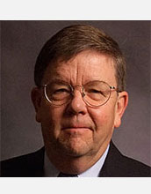

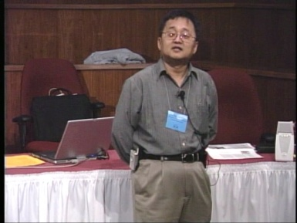
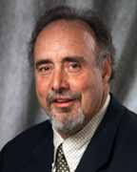

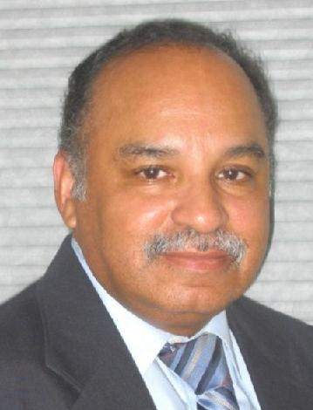
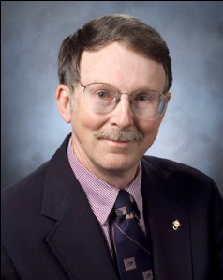
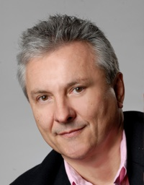
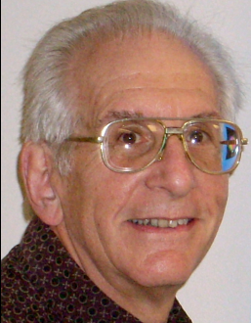
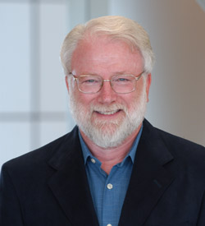


OK Supercomputing Symposium 2015
2003 Keynote:
Peter Freeman
NSF
Computer & Information
Science & Engineering
Assistant Director
2004 Keynote:
Sangtae Kim
NSF Shared
Cyberinfrastructure
Division Director
2005 Keynote:
Walt Brooks
NASA Advanced
Supercomputing
Division Director
2006 Keynote:
Dan Atkins
Head of NSF’s
Office of
Cyberinfrastructure
2007 Keynote:
Jay Boisseau
Director
Texas Advanced
Computing Center
U. Texas Austin
2008 Keynote: José Munoz Deputy Office Director/Senior Scientific Advisor NSF Office of Cyberinfrastructure
2009 Keynote: Douglass Post Chief Scientist US Dept of Defense HPC Modernization Program
FREE!
Wed Sep 23 2015
@ OU
Over 235 registra2ons already!
Over 152 inhe first day, over 200 in the first week, over 225 in the first month.
2011 Keynote: Barry Schneider Program Manager National Science Foundation
2012 Keynote: Thom Dunning Director National Center for Supercomputing Applications
2014 Keynote: Irene Qualters Division Director Advanced Cyberinfarstructure Division, NSF
Reception/Poster Session
Tue Sep 22 2015 @ OU
Symposium
Wed Sep 23 2015 @ OU
2010 Keynote: Horst Simon Deputy Director Lawrence Berkeley National Laboratory
2015 Keynote: John Shalf Dept Head CS Lawrence Berkeley Lab CTO, NERSC

Slide 20
Outline
What is GPGPU?
GPU Programming
Digging Deeper: CUDA on NVIDIA
CUDA Thread Hierarchy and Memory Hierarchy
CUDA Example: Matrix-Matrix Multiply

Slide 21
What is GPGPU?

Slide 22

Accelerators
No, not this ....
http://gizmodo.com/5032891/nissans-eco-gas-pedal-fights-back-to-help-you-save-gas

Slide 23
Accelerators
In HPC, an accelerator is hardware component whose role is to speed up some aspect of the computing workload.
In the olden days (1980s), supercomputers sometimes had array processors, which did vector operations on arrays, and PCs sometimes had floating point accelerators: little chips that did the floating point calculations in hardware rather than software.
More recently, Field Programmable Gate Arrays (FPGAs) allow reprogramming deep into the hardware.

Slide 24
Why Accelerators are Good
Accelerators are good because:
they make your code run faster.

Slide 25
Why Accelerators are Bad
Accelerators are bad because:
they’re expensive;
they can be hard to program;
your code on them may not be portable to other accelerators, so the labor you invest in programming them can have a very short half-life.

Slide 26
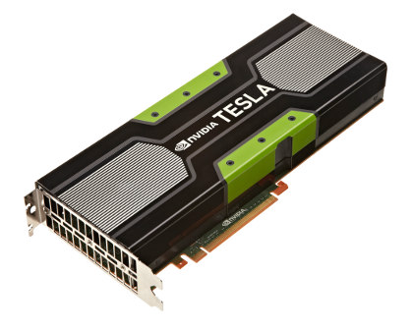
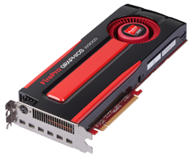
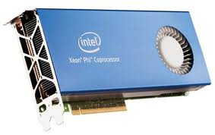
The King of the Accelerators
The undisputed champion of accelerators is:
the graphics processing unit.
http://www.amd.com/us-en/assets/content_type/DigitalMedia/46928a_01_ATI-FirePro_V8700_angled_low_res.gif
http://blog.xcelerit.com/benchmarks-nvidia-kepler-vs-fermi/
http://www.overclockers.ua/news/cpu/106612-Knights-Ferry.jpg

Slide 27
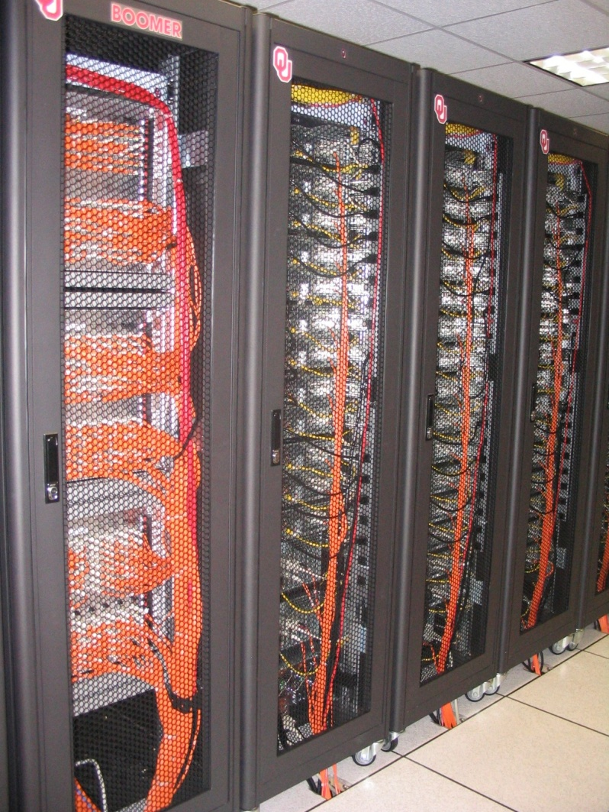
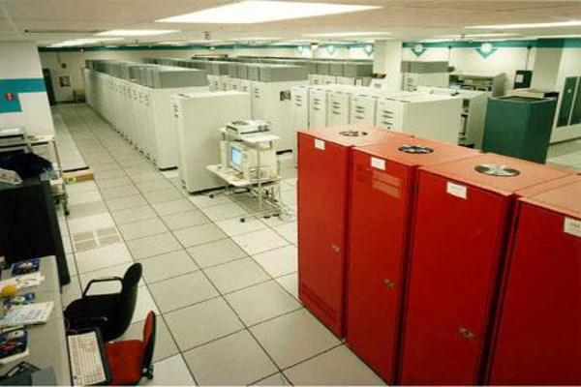

What does 1 TFLOPs Look Like?
2002: Row
2012: Card
1997: Room
AMD FirePro W9000^{[14]}
ASCI RED^{[13]}
Sandia National Lab
NVIDIA Kepler K20^{[15]}
boomer.oscer.ou.edu
In service 2002-5: 11 racks
Intel MIC Xeon PHI^{[16]}

Slide 28
Why GPU?
Graphics Processing Units (GPUs) were originally designed to accelerate graphics tasks like image rendering.
They became very very popular with videogamers, because they’ve produced better and better images, and lightning fast.
And, prices have been extremely good, ranging from three figures at the low end to four figures at the high end.

Slide 29
GPUs are Popular
Chips are expensive to design (hundreds of millions of $$$), expensive to build the factory for (billions of $$$), but cheap to produce.
For example, in FY2013, NVIDIA sold about $2-3B of GPUs (out of something like $4B total revenue).
For example, in 2013, GPUs sold 413 million units.
  http://www.tgdaily.com/enterprise/126591-graphics-chips-market-is-showing-some-life
This means that the GPU companies have been able to recoup the huge fixed costs.

Slide 30
GPU Do Arithmetic
GPUs mostly do stuff like rendering images.
This is done through mostly floating point arithmetic – the same stuff people use supercomputing for!

Slide 31
GPU Programming

Slide 32
Hard to Program?
In the olden days – that is, until just the last few years – programming GPUs meant either:
  using a graphics standard like OpenGL (which is mostly meant for rendering), or
  getting fairly deep into the graphics rendering pipeline.
To use a GPU to do general purpose number crunching, you had to make your number crunching pretend to be graphics.
This was hard. So most people didn’t bother.

Slide 33
Easy to Program?
More recently, GPU manufacturers have worked hard to make GPUs easier to use for general purpose computing.
This is known as General Purpose Graphics Processing Units.

Slide 34
Intel MIC
First production (non-research) model: Xeon Phi.
Not a graphics card.
But, has similar structure to a graphics card, just without the graphics.
Based on x86: can use a lot of the same tools as CPU.
61 x86 cores, 512-bit vector widths (8-way double precision floating point vectors, up to 16 DP floating point calculations per clock cycle using Fused Multiply-Add).
8 GB GDDR5 Graphics RAM, 352 GB/sec
Peak ~1070 GFLOPs per card (i.e., OSCER’s first cluster supercomputer in 2002).
http://www.tacc.utexas.edu/user-services/user-guides/stampede-user-guide
https://secure-software.intel.com/sites/default/files/article/334766/intel-xeon-phi-systemsoftwaredevelopersguide.pdf

Slide 35
How to Program a GPU
Proprietary programming language or extensions
  NVIDIA: CUDA (C/C++)
  AMD/ATI: StreamSDK/Brook+ (C/C++) – defunct
OpenCL (Open Computing Language): an industry standard for doing number crunching on GPUs.
Portland Group Inc (PGI) Fortran and C compilers with accelerator directives; PGI CUDA Fortran (Fortran 90 equivalent of NVIDIA’s CUDA C).
  PGI is now part of NVIDIA.
OpenACC accelerator directives for NVIDIA and AMD
OpenMP version 4.0 includes accelerator and vectorization directives.

Slide 36
NVIDIA CUDA
NVIDIA proprietary
Formerly known as “Compute Unified Device Architecture”
Extensions to C to allow better control of GPU capabilities
Modest extensions but major rewriting of the code
Portland Group Inc (PGI) has released a Fortran implementation of CUDA available in their Fortran compiler.
  PGI is now part of NVIDIA.

Slide 37
CUDA Example Part 1
// example1.cpp : Defines the entry point for the console application.
//
#include "stdafx.h"
#include <stdio.h>
#include <cuda.h>
// Kernel that executes on the CUDA device
__global__ void square_array(float *a, int N)
{
int idx = blockIdx.x * blockDim.x + threadIdx.x;
if (idx<N) a[idx] = a[idx] * a[idx];
}
http://llpanorama.wordpress.com/2008/05/21/my-first-cuda-program/

Slide 38
CUDA Example Part 2
// main routine that executes on the host
int main(void)
{
float *a_h, *a_d; // Pointer to host & device arrays
const int N = 10; // Number of elements in arrays
size_t size = N * sizeof(float);
a_h = (float *)malloc(size); // Allocate array on host
cudaMalloc((void **) &a_d, size); // Allocate array on device
// Initialize host array and copy it to CUDA device
for (int i=0; i<N; i++) a_h[i] = (float)i;
cudaMemcpy(a_d, a_h, size, cudaMemcpyHostToDevice);
// Do calculation on device:
int block_size = 4;
int n_blocks = N/block_size + (N%block_size == 0 ? 0:1);
square_array <<< n_blocks, block_size >>> (a_d, N);
// Retrieve result from device and store it in host array
cudaMemcpy(a_h, a_d, sizeof(float)*N, cudaMemcpyDeviceToHost);
// Print results
for (int i=0; i<N; i++) printf("%d %f\n", i, a_h[i]);
// Cleanup
free(a_h); cudaFree(a_d);
}

Slide 39
OpenCL
Open Computing Language
Open standard developed by the Khronos Group, which is a consortium of many companies (including NVIDIA, AMD and Intel, but also lots of others)
Initial version of OpenCL standard released in Dec 2008.
Many companies are creating their own implementations.
Apple was first to market, with an OpenCL implementation included in Mac OS X v10.6 (“Snow Leopard”) in 2009.
Currently on version 2.1 (released March 3 2015).

Slide 40
OpenCL Example Part 1
// create a compute context with GPU device
context =
clCreateContextFromType(NULL, CL_DEVICE_TYPE_GPU, NULL, NULL, NULL);
// create a command queue
queue = clCreateCommandQueue(context, NULL, 0, NULL);
// allocate the buffer memory objects
memobjs[0] = clCreateBuffer(context,
CL_MEM_READ_ONLY | CL_MEM_COPY_HOST_PTR,
sizeof(float)*2*num_entries, srcA, NULL);
memobjs[1] = clCreateBuffer(context,
CL_MEM_READ_WRITE,
sizeof(float)*2*num_entries, NULL, NULL);
// create the compute program
program = clCreateProgramWithSource(context, 1, &fft1D_1024_kernel_src,
NULL, NULL);
http://en.wikipedia.org/wiki/OpenCL

Slide 41
OpenCL Example Part 2
// build the compute program executable
clBuildProgram(program, 0, NULL, NULL, NULL, NULL);
// create the compute kernel
kernel = clCreateKernel(program, "fft1D_1024", NULL);
// set the args values
clSetKernelArg(kernel, 0, sizeof(cl_mem), (void *)&memobjs[0]);
clSetKernelArg(kernel, 1, sizeof(cl_mem), (void *)&memobjs[1]);
clSetKernelArg(kernel, 2, sizeof(float)*(local_work_size[0]+1)*16, NULL);
clSetKernelArg(kernel, 3, sizeof(float)*(local_work_size[0]+1)*16, NULL);
// create N-D range object with work-item dimensions and execute kernel
global_work_size[0] = num_entries; local_work_size[0] = 64;
clEnqueueNDRangeKernel(queue, kernel, 1, NULL,
global_work_size, local_work_size, 0, NULL, NULL);

Slide 42
OpenCL Example Part 3
// This kernel computes FFT of length 1024. The 1024 length FFT is
// decomposed into calls to a radix 16 function, another radix 16
// function and then a radix 4 function
__kernel void fft1D_1024 (__global float2 *in, __global float2 *out,
__local float *sMemx, __local float *sMemy) {
int tid = get_local_id(0);
int blockIdx = get_group_id(0) * 1024 + tid;
float2 data[16];
// starting index of data to/from global memory
in = in + blockIdx;
out = out + blockIdx;
globalLoads(data, in, 64); // coalesced global reads
fftRadix16Pass(data); // in-place radix-16 pass
twiddleFactorMul(data, tid, 1024, 0);

Slide 43
OpenCL Example Part 4
// local shuffle using local memory
localShuffle(data, sMemx, sMemy, tid, (((tid & 15) * 65) + (tid >> 4)));
fftRadix16Pass(data); // in-place radix-16 pass
twiddleFactorMul(data, tid, 64, 4); // twiddle factor multiplication
localShuffle(data, sMemx, sMemy, tid, (((tid >> 4) * 64) + (tid & 15)));
// four radix-4 function calls
fftRadix4Pass(data); // radix-4 function number 1
fftRadix4Pass(data + 4); // radix-4 function number 2
fftRadix4Pass(data + 8); // radix-4 function number 3
fftRadix4Pass(data + 12); // radix-4 function number 4
// coalesced global writes
globalStores(data, out, 64);
}

Slide 44
Portland Group Accelerator Directives
Proprietary directives in Fortran and C
Similar to OpenMP in structure
If the compiler doesn’t understand these directives, it ignores them, so the same code can work with an accelerator or without, and with the PGI compilers or other compilers.
The directives tell the compiler what parts of the code happen in the accelerator; the rest happens in the regular hardware.

Slide 45
PGI Accelerator Example
!$acc region
do k = 1,n1
do i = 1,n3
c(i,k) = 0.0
do j = 1,n2
c(i,k) = c(i,k) +
& a(i,j) * b(j,k)
enddo
enddo
enddo
!$acc end region
http://www.pgroup.com/resources/accel.htm

Slide 46
OpenACC Compiler Directives
Open standard for accelerator directives
Developed by NVIDIA, Cray, PGI, CAPS
Available in PGI and CAPS compilers for general cluster user, in Cray compilers for use on Crays
http://en.wikipedia.org/wiki/OpenACC

Slide 47
OpenACC Example Part 1 (C)
#include <stdio.h>
#include <stdlib.h>
void vecaddgpu( float *restrict r, float *a, float *b, int n ){
#pragma acc kernels loop copyin(a[0:n],b[0:n]) copyout(r[0:n])
for( int i = 0; i < n; ++i ) r[i] = a[i] + b[i];
}
/* http://www.pgroup.com/doc/openacc_gs.pdf */

Slide 48
OpenACC Example Part 2 (C)
int main( int argc, char* argv[] ){
int n; /* vector length */
float * a; /* input vector 1 */
float * b; /* input vector 2 */
float * r; /* output vector */
float * e; /* expected output values */
int i, errs;
if( argc > 1 ) n = atoi( argv[1] );
else n = 100000; /* default vector length */
if( n <= 0 ) n = 100000;
a = (float*)malloc( n*sizeof(float) );
b = (float*)malloc( n*sizeof(float) );
r = (float*)malloc( n*sizeof(float) );
e = (float*)malloc( n*sizeof(float) );
for( i = 0; i < n; ++i ){
a[i] = (float)(i+1);
b[i] = (float)(1000*i);
}

Slide 49
OpenACC Example Part 3 (C)
/* compute on the GPU */
vecaddgpu( r, a, b, n );
/* compute on the host to compare */
for( i = 0; i < n; ++i ) e[i] = a[i] + b[i];
/* compare results */
errs = 0;
for( i = 0; i < n; ++i ){
if( r[i] != e[i] ){
++errs;
}
}
printf( "%d errors found\n", errs );
return errs;
}

Slide 50
OpenACC Example Part 1 (F90)
module vecaddmod
implicit none
contains
subroutine vecaddgpu( r, a, b, n )
real, dimension(:) :: r, a, b
integer :: n
integer :: i
!$acc kernels loop copyin(a(1:n),b(1:n)) copyout(r(1:n))
do i = 1, n
r(i) = a(i) + b(i)
enddo
end subroutine
end module
! http://www.pgroup.com/doc/openacc_gs.pdf

Slide 51
OpenACC Example Part 2 (F90)
program main
use vecaddmod
implicit none
integer :: n, i, errs, argcount
real, dimension(:), allocatable :: a, b, r, e
character*10 :: arg1
argcount = command_argument_count()
n = 1000000 ! default value
if( argcount = 1 )then
call get_command_argument( 1, arg1 )
read( arg1, '(i)' ) n
if( n <= 0 ) n = 100000
endif
allocate( a(n), b(n), r(n), e(n) )
do i = 1, n
a(i) = i
b(i) = 1000*i
enddo

Slide 52
OpenACC Example Part 3 (F90)
! compute on the GPU
call vecaddgpu( r, a, b, n )
! compute on the host to compare
do i = 1, n
e(i) = a(i) + b(i)
enddo
! compare results
errs = 0
do i = 1, n
if( r(i) /= e(i) )then
errs = errs + 1
endif
enddo
print *, errs, ' errors found'
if( errs ) call exit(errs)
end program

Slide 53
OpenMP 4.0 Accelerator Directives
OpenMP’s 4.0 standard was released in 2013.
It appears has both accelerator directives and vectorization directives.
It’s the lingua franca of the Intel MIC accelerator.

Slide 54
OpenMP Accelerator Example (F90)
! snippet from the hand-coded subprogram...
!dir$ attributes offload:mic :: my_sgemm
subroutine my_sgemm(d,a,b)
real, dimension(:,:) :: a, b, d
!$omp parallel do
do j=1, n
do i=1, n
d(i,j) = 0.0
do k=1, n
d(i,j) = d(i,j)+a(i,k)*b(k,j)
enddo
enddo
enddo
end subroutine
http://www.cac.cornell.edu/education/training/ParallelFall2012/OpenMPNov2012.pdf

Slide 55
Digging Deeper:
CUDA on NVIDIA

Slide 56
NVIDIA Tesla
NVIDIA offers a GPU platform named Tesla.
It consists essentially of their highest end graphics card, minus the video out connector.

Slide 57

NVIDIA Tesla K80 Card Specs
4992 GPU cores
562 MHz core clock, 875 GHz boost clock
Single precision floating point performance: 1 8740 GFLOPs (2 single precision flops per clock per core)
Double precision floating point performance: 2910 GFLOPs (2/3 double precision flop per clock per core)
Internal RAM: 24 GB DDR5
Internal RAM speed: 480 GB/sec (compared ~100 GB/sec for regular RAM)
Has to be plugged into a PCIe slot (at most 16 GB/sec per GPU card)
http://www.nvidia.com/object/tesla-servers.html
http://www.anandtech.com/show/8729/nvidia-launches-tesla-k80-gk210-gpu
http://en.wikipedia.org/wiki/Nvidia_Tesla

Slide 58
Compare Top x86 vs NVIDIA K80
Let’s compare the best dual socket x86 server today vs K80.
 | Dual socket, Intel 2.3 GHz 18-core | NVIDIA Tesla K80 dual cards in an x86 server
Peak DP FLOPs | 1324.8 GFLOPs DP | 5820 GFLOPs DP (4.4x)
Peak SP FLOPS | 2649.6 GFLOPs SP | 17,480 GFLOPs SP (6.6x)
Peak RAM BW | ~100 GB/sec | ~480 GB/sec (4.8x)
Peak PCIe BW | N/A | 16 GB/sec
Needs x86 server to be part of? | No | Yes
Power/Heat | ~350 W | 2 × 300 W + ~400 W (~2.9x)
Code portable? | Yes | No (CUDA) Yes (OpenACC, OpenCL)

Slide 59
Compare Top x86 vs NVIDIA K80
Here are some interesting measures:
 | Dual socket, Intel 2.3 GHz 18-core | NVIDIA Tesla K80
DP GFLOPs/Watt | ~3.8 GFLOPs/Watt | ~5.8 GFLOPs/Watt (~1.5x)
SP GFLOPS/Watt | ~7.6 GFLOPs/Watt | ~17.5 GFLOPs/Watt (~2.3x)
DP TFLOPs/sq ft | ~10.6 TFLOPs/sq ft | ~23.3 TFLOPs/sq ft (2.2x)
SP TFLOPs/sq ft | ~21.2 TFLOPs/sq ft | ~69.9 TFLOPs/sq ft (3.3x)
Racks per PFLOP DP | 16 racks/PFLOP DP | 8 racks/PFLOP DP (50%)
Racks per PFLOP SP | 8 racks/PFLOP SP | 3 racks/PFLOP SP (38%)

Slide 60
What Are the Downsides?
You have to rewrite your code into CUDA or OpenCL or PGI accelerator directives (or someday maybe OpenMP).
  CUDA: Proprietary
  OpenCL: portable but cumbersome
  OpenACC, OpenMP 4.0: portable, but which to choose?
    They may be merging ….

Slide 61
Programming for Performance
The biggest single performance bottleneck on GPU cards today is the PCIe slot:
PCI 3.0 x16: 16 GB/sec
2133 MHz current architectures: up to ~100 GB/sec per server
GDDR5 accelerator card RAM: 480 GB/sec per card
Your goal:
At startup, move the data from x86 server RAM into accelerator RAM.
Do almost all the work inside the accelerator.
Use the x86 server only for I/O and message passing, to minimize the amount of data moved through the PCIe slot.

Slide 62
TENTATIVE Schedule
Tue Jan 20: GPGPU: What the Heck is Supercomputing?
Tue Jan 27: The Tyranny of the Storage Hierarchy
Tue Feb 3: Instruction Level Parallelism
Tue Feb 10: Stupid Compiler Tricks
Tue Feb 17: Shared Memory Multithreading
Tue March 3: Distributed Multiprocessing
Tue March 10: Applications and Types of Parallelism
Tue March 17: NO SESSION (OU's Spring Break)
Tue March 24: NO SESSION (Henry has a huge grant proposal due)
Tue March 31: GPGPU Madness
Tue Apr 14: High Throughput Computing
Tue Apr 14: GPGPU: Number Crunching in Your Graphics Card
Tue Apr 21: Grab Bag: Scientific Libraries, I/O Libraries, Visualization

Slide 63
Thanks for helping!
OU IT
  OSCER operations staff (Brandon George, Dave Akin, Brett Zimmerman, Josh Alexander, Patrick Calhoun)
  Horst Severini, OSCER Associate Director for Remote & Heterogeneous Computing
  Debi Gentis, OSCER Coordinator
  Jim Summers
  The OU IT network team
James Deaton, Skyler Donahue, Jeremy Wright and Steven Haldeman, OneNet
Kay Avila, U Iowa
Stephen Harrell, Purdue U

Slide 64
Coming in 2015!
Linux Clusters Institute workshop May 18-22 2015 @ OU
http://www.linuxclustersinstitute.org/workshops/
Great Plains Network Annual Meeting, May 27-29, Kansas City
Advanced Cyberinfrastructure Research & Education Facilitators (ACI-REF) Virtual Residency May 31 - June 6 2015
XSEDE2015, July 26-30, St. Louis MO
https://conferences.xsede.org/xsede15
IEEE Cluster 2015, Sep 23-27, Chicago IL
http://www.mcs.anl.gov/ieeecluster2015/
OKLAHOMA SUPERCOMPUTING SYMPOSIUM 2015, Sep 22-23 2015 @ OU
SC13, Nov 15-20 2015, Austin TX
http://sc15.supercomputing.org/

Slide 65
OK Supercomputing Symposium 2015
2003 Keynote:
Peter Freeman
NSF
Computer & Information
Science & Engineering
Assistant Director
2004 Keynote:
Sangtae Kim
NSF Shared
Cyberinfrastructure
Division Director
2005 Keynote:
Walt Brooks
NASA Advanced
Supercomputing
Division Director
2006 Keynote:
Dan Atkins
Head of NSF’s
Office of
Cyberinfrastructure
2007 Keynote:
Jay Boisseau
Director
Texas Advanced
Computing Center
U. Texas Austin
2008 Keynote: José Munoz Deputy Office Director/Senior Scientific Advisor NSF Office of Cyberinfrastructure
2009 Keynote: Douglass Post Chief Scientist US Dept of Defense HPC Modernization Program
FREE!
Wed Sep 23 2015
@ OU
Over 235 registra2ons already!
Over 152 inhe first day, over 200 in the first week, over 225 in the first month.
2011 Keynote: Barry Schneider Program Manager National Science Foundation
2012 Keynote: Thom Dunning Director National Center for Supercomputing Applications
2014 Keynote: Irene Qualters Division Director Advanced Cyberinfarstructure Division, NSF
Reception/Poster Session
Tue Sep 22 2015 @ OU
Symposium
Wed Sep 23 2015 @ OU
2010 Keynote: Horst Simon Deputy Director Lawrence Berkeley National Laboratory
2015 Keynote: John Shalf Dept Head CS Lawrence Berkeley Lab CTO, NERSC

Slide 66
Thanks for your attention!
Questions? www.oscer.ou.edu

Slide 67
Does CUDA Help?
http://www.nvidia.com/object/IO_43499.html

Slide 68
CUDA
Thread Hierarchy and Memory Hierarchy
Some of these slides provided by Paul Gray, University of Northern Iowa

Slide 69
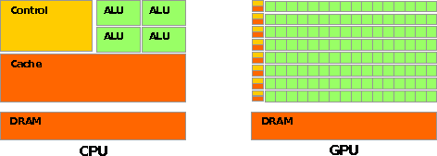
CPU vs GPU Layout
Source: NVIDIA CUDA Programming Guide

Slide 70
Buzzword: Kernel
In CUDA, a kernel is code (typically a function) that can be run inside the GPU.
Typically, the kernel code operates in lock-step on the stream processors inside the GPU.

Slide 71
Buzzword: Thread
In CUDA, a thread is an execution of a kernel with a given index.
Each thread uses its index to access a specific subset of the elements of a target array, such that the collection of all threads cooperatively processes the entire data set.
So these are very much like threads in the OpenMP or pthreads sense – they even have shared variables and private variables.

Slide 72
Buzzword: Block
In CUDA, a block is a group of threads.
Just like OpenMP threads, these could execute concurrently or independently, and in no particular order.
Threads can be coordinated somewhat, using the _syncthreads() function as a barrier, making all threads stop at a certain point in the kernel before moving on en mass. (This is like what happens at the end of an OpenMP loop.)

Slide 73
Buzzword: Grid
In CUDA, a grid is a group of (thread) blocks, with no synchronization at all among the blocks.

Slide 74
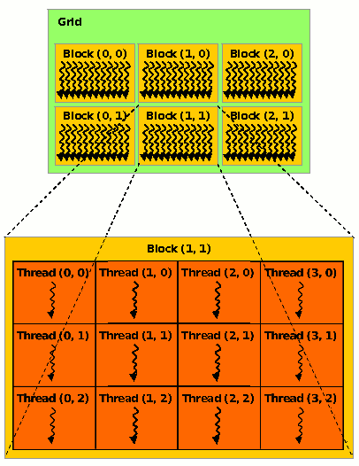
NVIDIA GPU Hierarchy
Grids map to GPUs
Blocks map to the MultiProcessors (MP)‏
  Blocks are never split across MPs, but an MP can have multiple blocks
Threads map to Stream Processors (SP)‏
Warps are groups of (32) threads that execute simultaneously
Image Source:
NVIDIA CUDA Programming Guide

Slide 75
CUDA Built-in Variables
blockIdx.x, blockIdx.y, blockIdx.z are built-in variables that returns the block ID in the x-axis, y-axis and z-axis of the block that is executing the given block of code.
threadIdx.x, threadIdx.y, threadidx.z are built-in variables that return the thread ID in the x-axis, y-axis and z-axis of the thread that is being executed by this stream processor in this particular block.
So, you can express your collection of blocks, and your collection of threads within a block, as a 1D array, a 2D array or a 3D array.
These can be helpful when thinking of your data as 2D or 3D.

Slide 76
__global__ Keyword
In CUDA, if a function is declared with the __global__ keyword, that means that it’s intended to be executed inside a GPU.
In CUDA, the term for the GPU is device, and the term for the x86 server is host.
So, a kernel runs on a device, while the main function, and so on, run on the host.
Note that a host can play host to multiple devices; for example, an S2050 server contains 4 C2050 GPU cards, and if a single host has two PCIe slots, then both of the PCIe plugs of the S2050 can be plugged into that same host.

Slide 77
Copying Data from Host to Device
If data need to move from the host (where presumably the data are initially input or generated), then a copy has to exist in both places.
Typically, what’s copied are arrays, though of course you can also copy a scalar (the address of which is treated as an array of length 1).

Slide 78
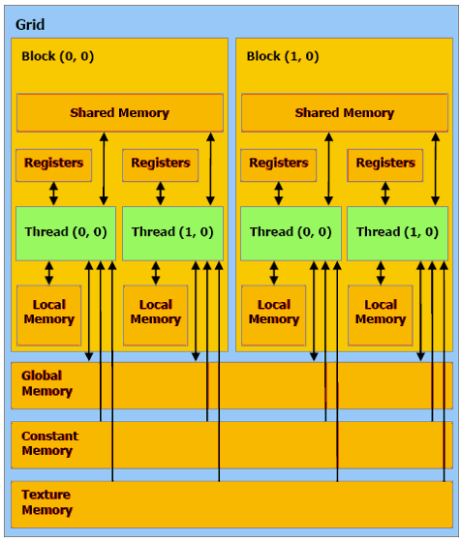
CUDA Memory Hierarchy #1
CUDA has a hierarchy of several kinds of memory:
Host memory (x86 server)
Device memory (GPU)
  Global: visible to all threads in all blocks – largest, slowest
  Shared: visible to all threads in a particular block – medium size, medium speed
  Local: visible only to a particular thread – smallest, fastest

Slide 79
CUDA Memory Hierarchy #2
CUDA has a hierarchy of several kinds of memory:
Host memory (x86 server)
Device memory (GPU)
  Constant: visible to all threads in all blocks; read only
  Texture: visible to all threads in all blocks; read only

Slide 80
CUDA Example:
Matrix-Matrix Multiply
http://developer.download.nvidia.com/compute/cuda/sdk/website/Linear_Algebra.html#matrixMul

Slide 81
Matrix-Matrix Multiply Main Part 1
float* host_A;
float* host_B;
float* host_B;
float* device_A;
float* device_B;
float* device_C;
host_A = (float*) malloc(mem_size_A);
host_B = (float*) malloc(mem_size_B);
host_C = (float*) malloc(mem_size_C);
cudaMalloc((void**) &device_A, mem_size_A);
cudaMalloc((void**) &device_B, mem_size_B);
cudamalloc((void**) &device_C, mem_size_C);
// Set up the initial values of A and B here.
// Henry says: I’ve oversimplified this a bit from
// the original example code.

Slide 82
Matrix-Matrix Multiply Main Part 2
// copy host memory to device
cudaMemcpy(device_A, host_A, mem_size_A,
cudaMemcpyHostToDevice);
cudaMemcpy(device_B, host_B, mem_size_B,
cudaMemcpyHostToDevice);
// setup execution parameters
dim3 threads(BLOCK_SIZE, BLOCK_SIZE);
dim3 grid(WC / threads.x, HC / threads.y);
// execute the kernel
matrixMul<<< grid, threads >>>(device_C,
device_A, device_B, WA, WB);
// copy result from device to host
cudaMemcpy(host_C, device_C, mem_size_C,
cudaMemcpyDeviceToHost);

Slide 83
Matrix Matrix Multiply Kernel Part 1
__global__ void matrixMul( float* C, float* A, float* B, int wA, int wB)
{
// Block index
int bx = blockIdx.x;
int by = blockIdx.y;
// Thread index
int tx = threadIdx.x;
int ty = threadIdx.y;
// Index of the first sub-matrix of A processed by the block
int aBegin = wA * BLOCK_SIZE * by;
// Index of the last sub-matrix of A processed by the block
int aEnd = aBegin + wA - 1;
// Step size used to iterate through the sub-matrices of A
int aStep = BLOCK_SIZE;
// Index of the first sub-matrix of B processed by the block
int bBegin = BLOCK_SIZE * bx;
// Step size used to iterate through the sub-matrices of B
int bStep = BLOCK_SIZE * wB;
// Csub is used to store the element of the block sub-matrix
// that is computed by the thread
float Csub = 0;

Slide 84
Matrix Matrix Multiply Kernel Part 2
// Loop over all the sub-matrices of A and B
// required to compute the block sub-matrix
for (int a = aBegin, b = bBegin;
a <= aEnd;
a += aStep, b += bStep) {
// Declaration of the shared memory array As used to
// store the sub-matrix of A
__shared__ float As[BLOCK_SIZE][BLOCK_SIZE];
// Declaration of the shared memory array Bs used to
// store the sub-matrix of B
__shared__ float Bs[BLOCK_SIZE][BLOCK_SIZE];
// Load the matrices from device memory
// to shared memory; each thread loads
// one element of each matrix
AS(ty, tx) = A[a + wA * ty + tx];
BS(ty, tx) = B[b + wB * ty + tx];
// Synchronize to make sure the matrices are loaded
__syncthreads();

Slide 85
Matrix Matrix Multiply Kernel Part 3
// Multiply the two matrices together;
// each thread computes one element
// of the block sub-matrix
for (int k = 0; k < BLOCK_SIZE; ++k)
Csub += AS(ty, k) * BS(k, tx);
// Synchronize to make sure that the preceding
// computation is done before loading two new
// sub-matrices of A and B in the next iteration
__syncthreads();
}
// Write the block sub-matrix to device memory;
// each thread writes one element
int c = wB * BLOCK_SIZE * by + BLOCK_SIZE * bx;
C[c + wB * ty + tx] = Csub;
}

Slide 86
Would We Really Do It This Way?
We wouldn’t really do matrix-matrix multiply this way.
NVIDIA has developed a CUDA implementation of the BLAS libraries, which include a highly tuned matrix-matrix multiply routine.
(We’ll learn about BLAS next time.)
There’s also a CUDA FFT library, if your code needs Fast Fourier Transforms.

Slide 87
Thanks for your attention!
Questions? www.oscer.ou.edu

